Slide 1

CSE3009 - Parallel and Distributed Computing Course Type: LTP Credits: 4
Prepared by
Dr Komarasamy G
Senior Associate Professor
School of Computing Science and Engineering
VIT Bhopal University

Slide 2
Course Objectives
1. To provide contemporary knowledge to students in parallel and distributed environment.
2. To provide students with abilities to analyze and design parallel and distributed applications.
3. In the development of parallel and distributed applications, apply core computer science concepts and algorithms.
4. To illustrate middleware technologies to support distributed applications.
5. To identify Distributed and parallel programs to improve performance and reliability.

Slide 3
Course Outcomes
Students will be able to
CO1: Analyze parallel and distributed system using the principles and concepts.[KL4]
CO2: Apply parallelize problems for load balancing. [KL3]
CO3 : Explain the challenges and opportunities that parallel and distributed systems present. [KL2]
CO4: Explain middleware technologies. RPC, RMI, and object-based[KL2]
CO5: Illustrate middleware technologies to support distributed applications. [KL2]
CO6: Identify Distributed and parallel programs to improve performance and reliability. [KL2]

Slide 4
Unit-1
Parallelism Fundamentals – Key Concepts and Challenges – Overview of Parallel computing – Flynn’s Taxonomy – Multi-Core Processors – Shared vs Distributed memory.
Performance of Parallel Computers, Performance Metrics for Processors, Parallel Programming Models, Parallel Algorithms.

Slide 5
Parallelism Fundamentals
Conventional architectures – consists of a processor, memory system, and the data path.
Each of these components present significant performance bottlenecks.
Parallelism addresses each of these components insignificant ways.
Different applications utilize different aspects of parallelism - e.g., data intensive applications utilize high aggregate throughput, server applications utilize high aggregate network bandwidth, and scientific applications typically utilize high processing and memory system performance.
It is important to understand each of these performance bottleneck.

Slide 6
Parallelism Fundamentals
Parallel computing -> process of executing several processors an application or computation simultaneously.
Generally, it is a kind of computing architecture where the large problems break into independent, smaller, usually similar parts that can be processed in one go.

Slide 7
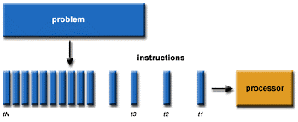
Parallelism Fundamentals
Traditionally software has been written for serial computations:
To be run on a single computer having a single Central Processing Unit (CPU)
A problem is broken into a discrete set of instructions
Instructions are executed one after another
Only one instruction can be executed at any moment in time

Slide 8

Parallelism Fundamentals
Parallel computing is the simultaneous use of multiple compute resources to solve a computational problem.
To be run using multiple CPUs
A problem is broken into discrete parts that can be solved concurrently
Each part is further broken down to a series of instructions
Instructions from each part execute simultaneously on different CPUs

Slide 9
Parallelism Fundamentals
Parallel computing also helps in faster application processing and task resolution by increasing the available computation power of systems.
The parallel computing principles are used by most supercomputers employ to operate.
The operational scenarios that need massive processing power or computation, generally, parallel processing is commonly used there.
The earliest computer software is written for serial computation as they are able to execute a single instruction at one time, but parallel computing is different where it executes several processors an application or computation in one time.

Slide 10
Parallelism Fundamentals
There are many reasons to use parallel computing, such as save time and money, provide concurrency, solve larger problems, etc.
Furthermore, parallel computing reduces complexity.
In the real-life example of parallel computing,
there are two queues to get a ticket of anything;
if two cashiers are giving tickets to 2 persons simultaneously,
it helps to save time as well as reduce complexity.

Slide 11
Key Concepts and Challenges
The compute resources can include:
A single computer with multiple processors;
An arbitrary number of computers connected by a network;
A combination of both.
The computational problem usually demonstrates characteristics such as the ability to be:
Broken apart into discrete pieces of work that can be solved simultaneously;
Execute multiple program instructions at any moment in time;
Solved in less time with multiple compute resources than with a single compute resource.

Slide 12
Types of parallel computing
1. Bit-level parallelism:
The form of parallel computing in which every task is dependent on processor word size.
In terms of performing a task on large-sized data, it reduces the number of instructions the processor must execute. There is a need to split the operation into series of instructions.
For example,
There is an 8-bit processor, and you want to do an operation on 16-bit numbers.
First, it must operate the 8 lower-order bits and then the 8 higher-order bits.
Therefore, two instructions are needed to execute the operation. The operation can be performed with one instruction by a 16-bit processor.

Slide 13
Types of parallel computing
2. Instruction-level parallelism:
In a single CPU clock cycle, the processor decides in instruction-level parallelism how many instructions are implemented at the same time. For each clock cycle phase, a processor in instruction-level parallelism can have the ability to address that is less than one instruction. The software approach in instruction-level parallelism functions on static parallelism, where the computer decides which instructions to execute simultaneously.
Task Parallelism:
Task parallelism is the form of parallelism in which the tasks are decomposed into subtasks.
Then, each subtask is allocated for execution. And, the execution of subtasks is performed concurrently by processors.

Slide 14
Applications of Parallel Computing
There are various applications of Parallel Computing, which are as follows:
One of the primary applications of parallel computing is Databases and Data mining.
The real-time simulation of systems is another use of parallel computing.
The technologies, such as Networked videos and Multimedia.
Science and Engineering.
Collaborative work environments.
The concept of parallel computing is used by augmented reality, advanced graphics, and virtual reality.

Slide 15
Advantages of Parallel computing
In parallel computing, more resources are used to complete the task that led to decrease the time and cut possible costs.
Comparing with Serial Computing, parallel computing can solve larger problems in a short time.
For simulating, modeling, and understanding complex, real-world phenomena, parallel computing is much appropriate while comparing with serial computing.
There are multiple problems that are very large and may impractical or impossible to solve them on a single computer;
It allows you to do several things in a time by using multiple computing resources.
Parallel computing is suited for hardware as serial computing wastes the potential computing power.

Slide 16
Disadvantages of Parallel Computing
It addresses Parallel architecture that can be difficult to achieve.
In the case of clusters, better cooling technologies are needed in parallel computing.
It requires the managed algorithms, which could be handled in the parallel mechanism.
The multi-core architectures consume high power consumption.
The parallel computing system needs low coupling and high cohesion, which is difficult to create.
The code for a parallelism-based program can be done by the most technically skilled and expert programmers.

Slide 17
Disadvantages of Parallel Computing
Although parallel computing helps you out to resolve computationally and the data-exhaustive issue with the help of using multiple processors, sometimes it affects the conjunction of the system and some of our control algorithms and does not provide good outcomes due to the parallel option.
Due to synchronization, thread creation, data transfers, and more, the extra cost sometimes can be quite large; even it may be exceeding the gains because of parallelization.
Moreover, for improving performance, the parallel computing system needs different code tweaking for different target architectures.

Slide 18
Overview or Why Parallel computing
The whole real-world runs in dynamic nature i.e. many things happen at a certain time but at different places concurrently. This data is extensively huge to manage.
Real-world data needs more dynamic simulation and modeling, and for achieving the same, parallel computing is the key.
Parallel computing provides concurrency and saves time and money.
Complex, large datasets, and their management can be organized and using parallel computing’s approach.
Ensures the effective utilization of the resources.
The hardware is guaranteed to be used effectively whereas in serial computation only some part of the hardware was used and the rest rendered idle.
Also, it is impractical to implement real-time systems using serial computing.

Slide 19
How does Computer Hardware Work
How does Computer Hardware Work|| 3D animation.
https://youtu.be/d86ws7mQYIg?si=ZWP7OoRO9AyObOGI

Slide 20
CSE3009 - Parallel and Distributed Computing Course Type: LTP Credits: 4
Prepared by
Dr Komarasamy G
Senior Associate Professor
School of Computing Science and Engineering
VIT Bhopal University

Slide 21
INTRODUCTION TO PARALLEL COMPUTING

Slide 22
OBJECTIVES:
To introduce you to the basic concepts and ideas in parallel computing
To familiarize you with the major programming models in parallel computing
To provide you with with guidance for designing efficient parallel programs

Slide 23
OUTLINE:
Introduction to Parallel Computing / High Performance Computing (HPC)
Concepts and terminology
Parallel programming models
Parallelizing your programs
Parallel examples

Slide 24
What is High Performance Computing?

Slide 25

What is High Performance Computing?

Slide 26

What is High Performance Computing?
Odyssey supercomputer is the major computational resource of FAS RC:
2,140 nodes / 60,000 cores
14 petabytes of storage

Slide 27
What is High Performance Computing?
Odyssey supercomputer is the major computational resource of FAS RC:
2,140 nodes / 60,000 cores
14 petabytes of storage
Using the world’s fastest and largest computers to solve large and complex problems.

Slide 28
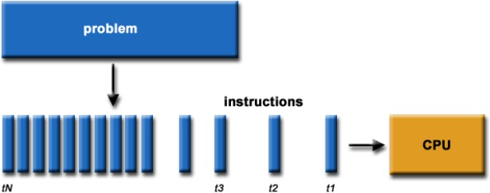
Serial Computation:
Traditionally software has been written for serial computations:
To be run on a single computer having a single Central Processing Unit (CPU)
A problem is broken into a discrete set of instructions
Instructions are executed one after another
Only one instruction can be executed at any moment in time

Slide 29
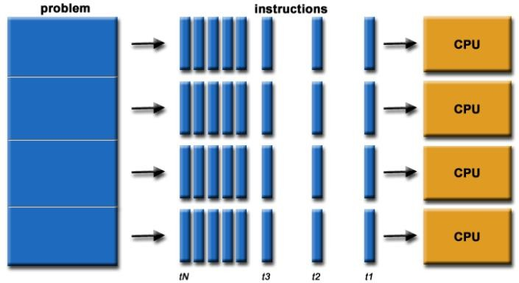
Parallel Computing:
In the simplest sense, parallel computing is the simultaneous use of multiple compute resources to solve a computational problem:
To be run using multiple CPUs
A problem is broken into discrete parts that can be solved concurrently
Each part is further broken down to a series of instructions
Instructions from each part execute simultaneously on different CPUs

Slide 30
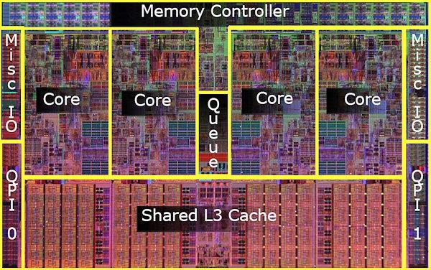
Parallel Computers:
Virtually all stand-alone computers today are parallel from a hardware perspective:
Multiple functional units (floating point, integer, GPU, etc.)
Multiple execution units / cores
Multiple hardware threads
Intel Core i7 CPU and its
major components
Image Credit: Intel

Slide 31
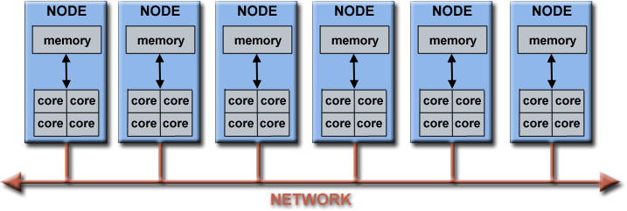
Parallel Computers:
Networks connect multiple stand-alone computers (nodes) to create larger parallel computer clusters
Each compute node is a multi-processor parallel computer in itself
Multiple compute nodes are networked together with an InfiniBand network
Special purpose nodes, also multi-processor, are used for other purposes

Slide 32




Why Use HPC?
Major reasons:
Save time and/or money: In theory, throwing more resources at a task will shorten its time to completion, with potential cost savings. Parallel clusters can be built from cheap, commodity components.
Solve larger problems: Many problems are so large and/or complex that it is impractical or impossible to solve them on a single computer, especially given limited computer memory.
Provide concurrency: A single compute resource can only do one thing at a time. Multiple computing resources can be doing many things simultaneously.
Use of non-local resources: Using compute resources on a wide area network, or even the Internet when local compute resources are scarce.

Slide 33
HPC Terminology:
Supercomputing / High-Performance Computing (HPC)
Flop(s) – Floating point operation(s)
Node – a stand alone computer
CPU / Core – a modern CPU usually has several cores (individual processing units )
Task – a logically discrete section from the computational work
Communication – data exchange between parallel tasks
Speedup – time of serial execution / time of parallel execution
Massively Parallel – refer to hardware of parallel systems with many processors (“many” = hundreds of thousands)
Pleasantly Parallel – solving many similar but independent tasks simultaneously. Requires very little communication
Scalability - a proportionate increase in parallel speedup with the addition of more processors

Slide 34
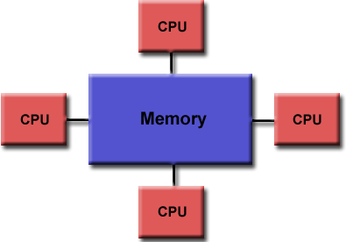
Parallel Computer Memory Architectures:
Shared Memory:
Multiple processors can operate independently, but share the same memory resources
Changes in a memory location caused by one
CPU are visible to all processors

Slide 35
Parallel Computer Memory Architectures:
Shared Memory:
Multiple processors can operate independently, but share the same memory resources
Changes in a memory location caused by one
CPU are visible to all processors
Advantages:
Global address space provides a user-friendly programming perspective to memory
Fast and uniform data sharing due to proximity of memory to CPUs
Disadvantages:
Lack of scalability between memory and CPUs. Adding more CPUs increases traffic on the shared memory-CPU path
Programmer responsibility for “correct” access to global memory

Slide 36
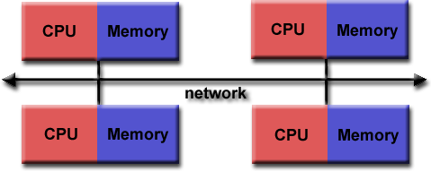
Parallel Computer Memory Architectures:
Distributed Memory:
Requires a communication network to connect inter-processor memory
Processors have their own local memory. Changes made by one CPU have no effect on others
Requires communication to exchange data among processors

Slide 37
Parallel Computer Memory Architectures:
Distributed Memory:
Requires a communication network to connect inter-processor memory
Processors have their own local memory. Changes made by one CPU have no effect on others
Requires communication to exchange data among processors
Advantages:
Memory is scalable with the number of CPUs
Each CPU can rapidly access its own memory without overhead incurred with trying to maintain global cache coherency
Disadvantages:
Programmer is responsible for many of the details associated with data communication between processors
It is usually difficult to map existing data structures to this memory organization, based on global memory

Slide 38
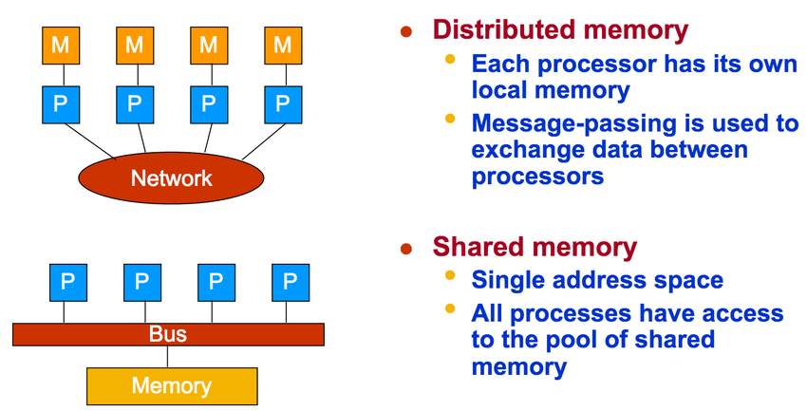
Shared vs Distributed memory

Slide 39
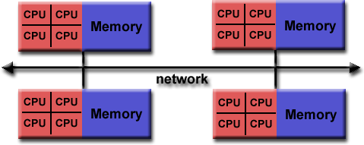

Parallel Computer Memory Architectures:
Hybrid Distributed-Shared Memory:
The largest and fastest computers in the world today employ both shared and distributed memory architectures.
Shared memory component can be a shared memory machine and/or GPU
Processors on a compute node share same memory space
Requires communication to exchange data between compute nodes

Slide 40
Parallel Computer Memory Architectures:
Hybrid Distributed-Shared Memory:
The largest and fastest computers in the world today employ both shared and distributed memory architectures.
Shared memory component can be a shared memory machine and/or GPU
Processors on a compute node share same memory space
Requires communication to exchange data between compute nodes
Advantages and Disadvantages:
Whatever is common to both shared and distributed memory architectures
Increased scalability is an important advantage
Increased programming complexity is a major disadvantage

Slide 41
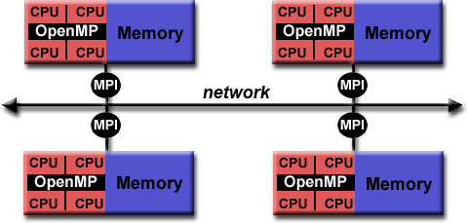
Hybrid Parallel Programming Models:
Currently, a common example of a hybrid model is the combination of the message passing model (MPI) with the threads model (OpenMP)
Threads perform computationally intensive kernels using local, on-node data
Communications between processes on different nodes occurs over the network using MPI
This hybrid model lends itself well to the increasingly common hardware environment of clustered multi/many-core machines

Slide 42
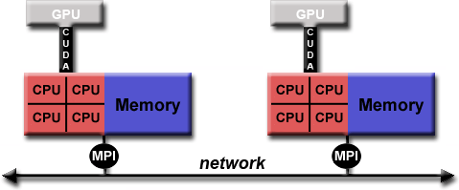
Hybrid Parallel Programming Models:
Another similar and increasingly popular example of a hybrid model is using MPI with GPU (Graphics Processing Unit) programming
GPUs perform computationally intensive kernels using local, on-node data
Communications between processes on different nodes occurs over the network using
MPI

Slide 43
Designing parallel programs - communication:
Most parallel applications require tasks to share data with each other.
Cost of communication: Computational resources are used to package and transmit data. Requires frequently synchronization – some tasks will wait instead of doing work. Could saturate network bandwidth.
Latency vs. Bandwidth: Latency is the time it takes to send a minimal message between two tasks. Bandwidth is the amount of data that can be communicated per unit of time. Sending many small messages can cause latency to dominate communication overhead.
Synchronous vs. Asynchronous communication: Synchronous communication is referred to as blocking communication – other work stops until the communication is completed.
Asynchronous communication is referred to as non-blocking since other work can be done while communication is taking place.

Slide 44
Languages using parallel computing:
C/C++
Fortran
MATLAB
Python
R
Perl
Julia
And others

Slide 45
CSE3009 - Parallel and Distributed Computing Course Type: LTP Credits: 4
Prepared by
Dr Komarasamy G
Senior Associate Professor
School of Computing Science and Engineering
VIT Bhopal University

Slide 46
Unit-1
Parallelism Fundamentals – Key Concepts and Challenges – Overview of Parallel computing – Flynn’s Taxonomy – Multi-Core Processors – Shared vs Distributed memory.
Performance of Parallel Computers, Performance Metrics for Processors, Parallel Programming Models, Parallel Algorithms.

Slide 47
Flynn’s Taxonomy
Parallel computing is computing where the jobs are broken into discrete parts that can be executed concurrently.
Each part is further broken down into a series of instructions.
Instructions from each piece execute simultaneously on different CPUs.
The breaking up of different parts of a task among multiple processors will help to reduce the amount of time to run a program.
Parallel systems deal with the simultaneous use of multiple computer resources that can include a single computer with multiple processors, a number of computers connected by a network to form a parallel processing cluster, or a combination of both.

Slide 48
Flynn’s Taxonomy
Parallel systems are more difficult to program than computers with a single processor because the architecture of parallel computers varies accordingly and the processes of multiple CPUs must be coordinated and synchronized. The difficult problem of parallel processing is portability.
An Instruction Stream is a sequence of instructions that are read from memory.
Data Stream is the operations performed on the data in the processor.
Flynn’s taxonomy is a classification scheme for computer architectures proposed by Michael Flynn in 1966.
The taxonomy is based on the number of instruction streams and data streams that can be processed simultaneously by a computer architecture.

Slide 49
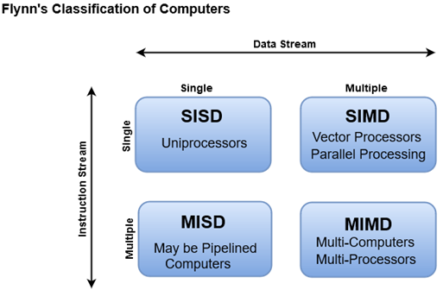
Flynn’s Taxonomy

Slide 50
Flynn’s Taxonomy
Single Instruction Single Data (SISD): In a SISD architecture, there is a single processor that executes a single instruction stream and operates on a single data stream. This is the simplest type of computer architecture and is used in most traditional computers.
Single Instruction Multiple Data (SIMD): In a SIMD architecture, there is a single processor that executes the same instruction on multiple data streams in parallel. This type of architecture is used in applications such as image and signal processing.
Multiple Instruction Single Data (MISD): In a MISD architecture, multiple processors execute different instructions on the same data stream. This type of architecture is not commonly used in practice, as it is difficult to find applications that can be decomposed into independent instruction streams.

Slide 51
Flynn’s Taxonomy
Multiple Instruction Multiple Data (MIMD): In a MIMD architecture, multiple processors execute different instructions on different data streams.
This type of architecture is used in distributed computing, parallel processing, and other high-performance computing applications.

Slide 52
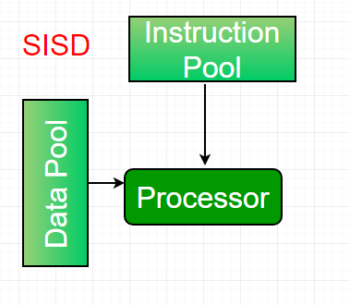
Flynn’s Taxonomy
Single-instruction, single-data (SISD) systems
An SISD computing system is a uniprocessor machine that is capable of executing a single instruction, operating on a single data stream. In SISD, machine instructions are processed in a sequential manner and computers adopting this model are popularly called sequential computers. Most conventional computers have SISD architecture.
All the instructions and data to be processed have to be stored in primary memory. The speed of the processing element in the SISD model is limited(dependent) by the rate at which the computer can transfer information internally. Dominant representative SISD systems are IBM PC, and workstations.

Slide 53
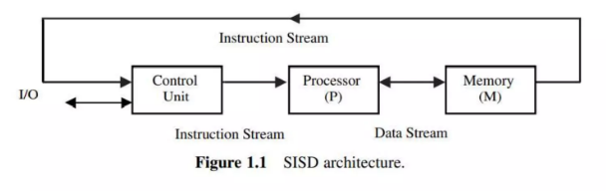
Flynn’s Taxonomy
Single-instruction, single-data (SISD) systems

Slide 54
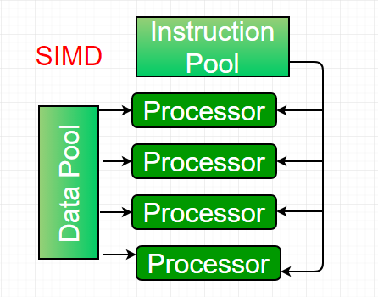
Flynn’s Taxonomy
Single-instruction, multiple-data (SIMD) systems
An SIMD system is a multiprocessor machine capable of executing the same instruction on all the CPUs but operating on different data streams. Machines based on a SIMD model are well suited to scientific computing since they involve lots of vector and matrix operations.
So that the information can be passed to all the processing elements (PEs) organized data elements of vectors can be divided into multiple sets(N-sets for N PE systems) and each PE can process one data set.
Dominant representative SIMD systems are Cray’s vector processing machines.

Slide 55
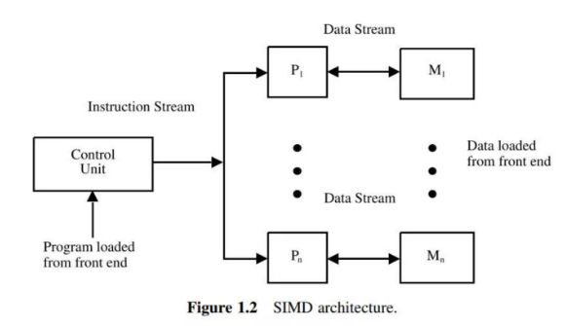
Flynn’s Taxonomy
Single-instruction, multiple-data (SIMD) systems

Slide 56
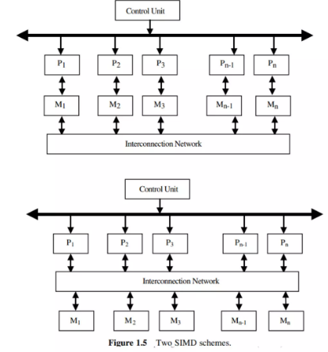
Flynn’s Taxonomy
Single-instruction, multiple-data (SIMD) systems

Slide 57
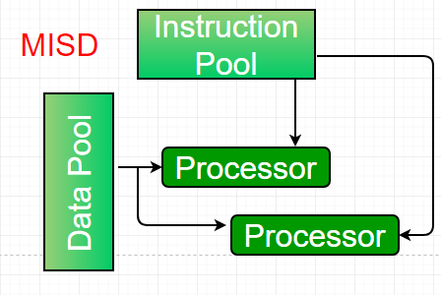
Flynn’s Taxonomy
Multiple-instruction, single-data (MISD) systems
An MISD computing system is a multiprocessor machine capable of executing different instructions on different PEs but all of them operate on the same dataset.
Example Z = sin(x)+cos(x)+tan(x) The system performs different operations on the same data set.
Machines built using the MISD model are not useful in most applications, a few machines are built, but none of them are available commercially.

Slide 58
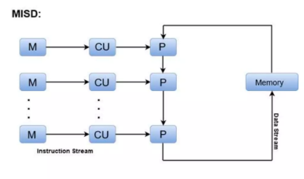
Flynn’s Taxonomy
Multiple-instruction, single-data (MISD) systems

Slide 59
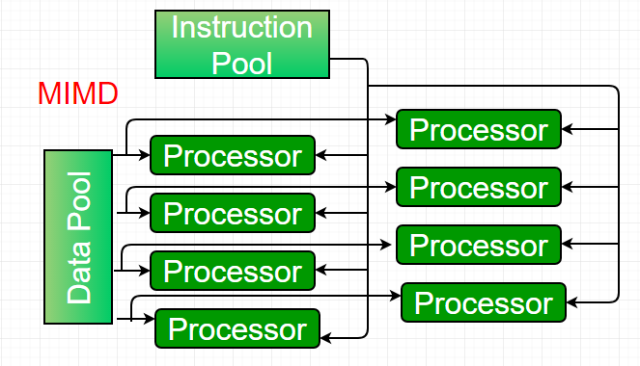
Flynn’s Taxonomy
Multiple-instruction, multiple-data (MIMD) systems
An MIMD system is a multiprocessor machine that is capable of executing multiple instructions on multiple data sets. Each PE in the MIMD model has separate instruction and data streams; therefore machines built using this model are capable of any application. Unlike SIMD and MISD machines, PEs in MIMD machines work asynchronously.

Slide 60
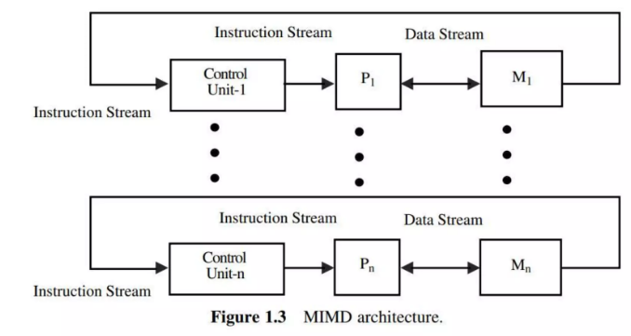
Flynn’s Taxonomy
Multiple-instruction, multiple-data (MIMD) systems

Slide 61
Flynn’s Taxonomy
MIMD machines are broadly categorized into shared-memory MIMD and distributed-memory MIMD based on the way PEs are coupled to the main memory.
In the shared memory MIMD model (tightly coupled multiprocessor systems), all the PEs are connected to a single global memory and they all have access to it.
The communication between PEs in this model takes place through the shared memory, modification of the data stored in the global memory by one PE is visible to all other PEs.
The dominant representative shared memory MIMD systems are Silicon Graphics machines and Sun/IBM’s SMP (Symmetric Multi-Processing).

Slide 62
Flynn’s Taxonomy
Different types of computer architectures that fall under Flynn’s taxonomy have their own advantages and disadvantages.
SISD architecture: This is the simplest and most common type of computer architecture. It is easy to program and debug and can handle a wide range of applications. However, it does not offer significant performance gains over traditional computing systems.
SIMD architecture: This type of architecture is highly parallel and can offer significant performance gains for applications that can be parallelized. However, it requires specialized hardware and software and is not well-suited for applications that cannot be parallelized.
MISD architecture: This type of architecture is not commonly used in practice, as it is difficult to find applications that can be decomposed into independent instruction streams.

Slide 63
Flynn’s Taxonomy
MIMD architecture: This type of architecture is highly parallel and can offer significant performance gains for applications that can be parallelized.
It is well-suited for distributed computing, parallel processing, and other high-performance computing applications.
However, it requires specialized hardware and software and can be challenging to program and debug.

Slide 64
Flynn’s Taxonomy
Features of Flynn’s taxonomy include:
Concurrency: Flynn’s taxonomy provides a way to classify computer architectures based on their concurrency, which refers to the number of tasks that can be executed simultaneously.
Performance: Different types of architectures have different performance characteristics, and Flynn’s taxonomy provides a way to compare their performance based on the number of concurrent instructions and data streams.
Parallelism: Flynn’s taxonomy highlights the importance of parallelism in computer architecture and provides a framework for designing and analyzing parallel processing systems.

Slide 65
Multi Core Processors
A multi-core processor is an integrated circuit with two or more processors connected to it for faster simultaneous processing of several tasks, reduced power consumption, and for greater performance. Generally, it is made up of two or more processors that read and execute program instructions.
In other words, on a single chip, a multi-core processor comprises numerous processing units, or "Cores," each of which has the potential to do distinct tasks.
For instance, if you are performing many tasks at once, such as watching a movie and using WhatsApp, one core will handle activities like watching a movie while the other handles other responsibilities like WhatsApp.
https://www.youtube.com/watch?v=Pr5yosuGZDc

Slide 66
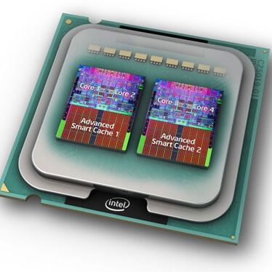
Multi Core Processors

Slide 67
Multi Core Processors
A dual-core configuration is comparable to having several different processors installed on the same computer, but the connection between them is faster because the two CPUs are plugged into the same socket.
Several instructions in parallel may be executed by individual cores, boosting the speed of software built to make use of the architecture's unique features.
As compared to a single-core processor, a dual-core processor usually is twice as powerful in ideal circumstances. In actuality, performance gains of around 50% are expected: a dual-core CPU is roughly 1.5 times as powerful as a single-core processor.

Slide 68
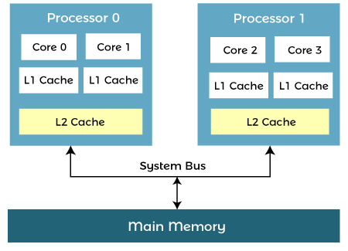
Architecture of Multicore Processor
A multi-core processor's design enables the communication between all available cores, and they divide and assign all processing duties appropriately. The processed data from each core is transmitted back to the computer's main board (Motherboard) via a single common gateway once all of the processing operations have been finished. This method beats a single-core CPU in terms of total performance.

Slide 69
Architecture of Multicore Processor
Advantages of Multi-Core Processor
Performance
A multi-core CPU, by nature, can do more work as compared to a single-core processor. The spacing between the cores of an integrated circuit allows for faster clock rates. As a result, the signals do not need to travel a large distance to reach their target and are also persistent. When compared to using a separate processor, the speeds are far quicker.
Reliability
In multi-core CPUs, the software is always assigned to different cores. When one piece of software fails, the others remain unaffected. Whenever a defect arises, it affects only one core. As a result, multi-core CPUs are better able to resist faults.
Software Interactions
Even if the software is running on multiple cores, it will communicate with one another. Spatial and temporal isolation is a process that a multi-core processor goes through. Core threads are never delayed as a result of these processes.

Slide 70
Architecture of Multicore Processor
Multitasking
An operating system can use a multi-core CPU to run two or more processes at the same time, even if many programmes may be executed at the same time. A photoshop application, for example, can be used to perform two jobs at once.
Power Consumption
Multitasking with a multi-core CPU, on the other hand, requires less power. Only the part of the CPU that generates heat will be used. The power consumption is eventually minimized, resulting in less battery utilization. Some operating systems, on the other hand, need more resources as compared to others.
Obsolescence Avoidance
Architects can avoid technology obsolescence and increase maintainability by using multicore CPUs. Chipmakers are using the most recent technological advancements in their multicore CPUs. Single-core chips are becoming increasingly difficult to come by as the number of cores increases.

Slide 71
Architecture of Multicore Processor
Multicore processors may increase (but do not guarantee) geographical and temporal isolation when compared to single-core systems.
Software on one core is less likely to impact software on the other if both cores are executing on the same single-core.
This decoupling happens due to geographical and temporal isolation (threads on one core are not delayed by threads on another core).
With the help of limiting the impact of errors to a single core, multicore processing can increase robustness.
When executing mixed-criticality programmes separately, this enhanced isolation is very important (safety-critical, mission-critical, and security-critical).
More details
https://www.javatpoint.com/what-is-a-multicore-processor
https://www.techtarget.com/searchdatacenter/definition/multi-core-processor

Slide 72
CSE3009 - Parallel and Distributed Computing Course Type: LTP Credits: 4
Prepared by
Dr Komarasamy G
Senior Associate Professor
School of Computing Science and Engineering
VIT Bhopal University

Slide 73
Unit-1
Parallelism Fundamentals – Key Concepts and Challenges – Overview of Parallel computing – Flynn’s Taxonomy – Multi-Core Processors – Shared vs Distributed memory.
Performance of Parallel Computers, Performance Metrics for Processors, Parallel Programming Models, Parallel Algorithms.

Slide 74
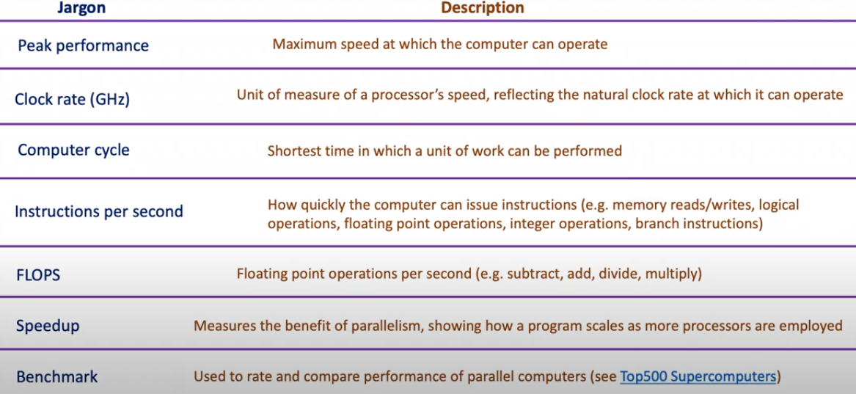
Performance of Parallel Computers

Slide 75
Performance Metrics for Processors
Processor speed: The speed of the processor, measured in GHz (gigahertz), determines how quickly the computer can execute instructions and process data.
Memory: The amount and speed of the memory, including RAM (random access memory) and cache memory, can impact how quickly data can be accessed and processed by the computer.
Storage: The speed and capacity of the storage devices, including hard drives and solid-state drives (SSDs), can impact the speed at which data can be stored and retrieved.
I/O devices: The speed and efficiency of input/output devices, such as keyboards, mice, and displays, can impact the overall performance of the system.
Software optimization: The efficiency of the software running on the system, including operating systems and applications, can impact how quickly tasks can be completed.

Slide 76
Parallel Programming Models
There are several parallel programming models in common use:
Shared Memory (without threads)
Threads
Distributed Memory / Message Passing
Data Parallel
Hybrid
Single Program Multiple Data (SPMD)
Multiple Program Multiple Data (MPMD)

Slide 77
Parallel Programming Models
1. Shared Memory Model (without threads)
processes/tasks share a common address space, which they read and write to asynchronously.
Various mechanisms such as locks / semaphores are used to control access to the shared memory, resolve contentions and to prevent race conditions and deadlocks.
This is perhaps the simplest parallel programming model.
Advantage of this model from the programmer's point of view is that the notion of data "ownership" is lacking, so there is no need to specify explicitly the communication of data between tasks. All processes see and have equal access to shared memory. Program development can often be simplified.

Slide 78
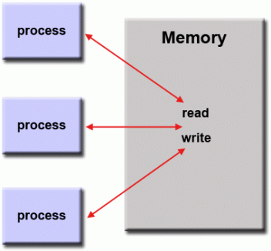
Parallel Programming Models
Shared memory model

Slide 79
Parallel Programming Models
Disadvantage in terms of performance is that it becomes more difficult to understand and manage data locality:
Keeping data local to the process that works on it conserves memory accesses, cache refreshes and bus traffic that occurs when multiple processes use the same data.
Unfortunately, controlling data locality is hard to understand and may be beyond the control of the average user.

Slide 80
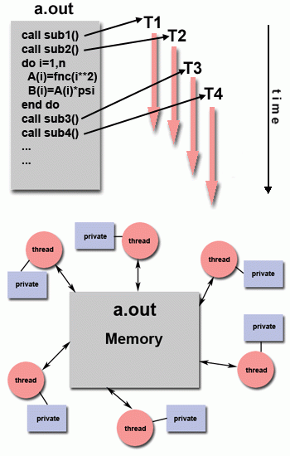
Parallel Programming Models
2. Threads Model
This programming model is a type of shared memory programming.
In the threads model of parallel programming, a single "heavy weight" process can have multiple "light weight", concurrent execution paths.

Slide 81
Parallel Programming Models
For example:
The main program a.out is scheduled to run by the native operating system. a.out loads and acquires all of the necessary system and user resources to run. This is the "heavy weight" process.
a.out performs some serial work, and then creates a number of tasks (threads) that can be scheduled and run by the operating system concurrently.
Each thread has local data, but also, shares the entire resources of a.out. This saves the overhead associated with replicating a program's resources for each thread ("light weight"). Each thread also benefits from a global memory view because it shares the memory space of a.out.

Slide 82
Parallel Programming Models
A thread's work may best be described as a subroutine within the main program. Any thread can execute any subroutine at the same time as other threads.
Threads communicate with each other through global memory (updating address locations). This requires synchronization constructs to ensure that more than one thread is not updating the same global address at any time.
Threads can come and go, but a.out remains present to provide the necessary shared resources until the application has completed.

Slide 83
Parallel Programming Models
3. Distributed Memory / Message Passing Model
This model demonstrates the following characteristics:
A set of tasks that use their own local memory during computation.
Multiple tasks can reside on the same physical machine and/or across an arbitrary number of machines.
Tasks exchange data through communications by sending and receiving messages.
Data transfer usually requires cooperative operations to be performed by each process.
For example, a send operation must have a matching receive operation.

Slide 84
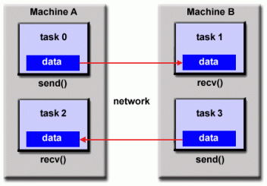
Parallel Programming Models
3. Distributed Memory / Message Passing Model

Slide 85
Parallel Programming Models
4. Data Parallel Model
May also be referred to as the Partitioned Global Address Space (PGAS) model.
The data parallel model demonstrates the following characteristics:
Address space is treated globally
Most of the parallel work focuses on performing operations on a data set. The data set is typically organized into a common structure, such as an array or cube.
A set of tasks work collectively on the same data structure, however, each task works on a different partition of the same data structure.
Tasks perform the same operation on their partition of work, for example, "add 4 to every array element“.

Slide 86
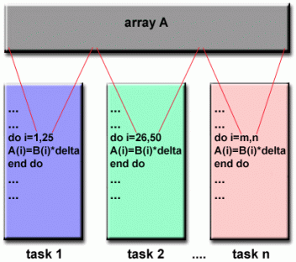
Parallel Programming Models
4. Data Parallel Model
On shared memory architectures, all tasks may have access to the data structure through global memory.
On distributed memory architectures, the global data structure can be split up logically and/or physically across tasks.

Slide 87
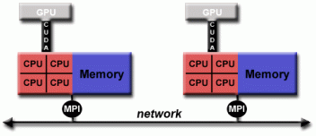
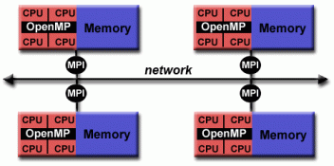
Parallel Programming Models
5. Hybrid Model
A hybrid model combines more than one of the previously described programming models.
Hybrid model with MPI and CUDA
Hybrid model with MPI and OpenMP

Slide 88
Parallel Programming Models
5. Hybrid Model
Currently, a common example of a hybrid model is the combination of the message passing model (MPI) with the threads model (OpenMP).
Threads perform computationally intensive kernels using local, on-node data
Communications between processes on different nodes occurs over the network using MPI
This hybrid model lends itself well to the most popular (currently) hardware environment of clustered multi/many-core machines.

Slide 89
Parallel Programming Models
5. Hybrid Model
Another similar and increasingly popular example of a hybrid model is using MPI with CPU-GPU (graphics processing unit) programming.
MPI tasks run on CPUs using local memory and communicating with each other over a network.
Computationally intensive kernels are off-loaded to GPUs on-node.
Data exchange between node-local memory and GPUs uses CUDA (or something equivalent).
Other hybrid models are common:
MPI with Pthreads
MPI with non-GPU accelerators

Slide 90
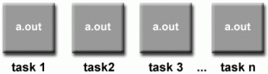
Parallel Programming Models
6. Single Program Multiple Data (SPMD)
SPMD is actually a "high level" programming model that can be built upon any combination of the previously mentioned parallel programming models.
SINGLE PROGRAM: All tasks execute their copy of the same program simultaneously. This program can be threads, message passing, data parallel or hybrid.
MULTIPLE DATA: All tasks may use different data

Slide 91
Parallel Programming Models
6. Single Program Multiple Data (SPMD)
SPMD programs usually have the necessary logic programmed into them to allow different tasks to branch or conditionally execute only those parts of the program they are designed to execute. That is, tasks do not necessarily have to execute the entire program - perhaps only a portion of it.
The SPMD model, using message passing or hybrid programming, is probably the most commonly used parallel programming model for multi-node clusters.

Slide 92
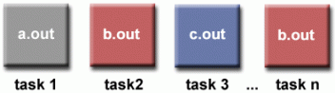
Parallel Programming Models
7. Multiple Program Multiple Data (MPMD)
Like SPMD, MPMD is actually a "high level" programming model that can be built upon any combination of the previously mentioned parallel programming models.
MULTIPLE PROGRAM: Tasks may execute different programs simultaneously. The programs can be threads, message passing, data parallel or hybrid.
MULTIPLE DATA: All tasks may use different data
MPMD applications are not as common as SPMD applications, but may be better suited for certain types of problems, particularly those that lend themselves better to functional decomposition than domain decomposition (discussed later under Partitioning).
https://hpc.llnl.gov/documentation/tutorials/introduction-parallel-computing-tutorial##Examples

Slide 93
Parallel Algorithms
Parallel algorithms are methods for organizing the computational work of a given application such that multiple parts of the workload can be performed concurrently to reduce the time to solution and increase performance.
An algorithm is a sequence of steps that take inputs from the user and after some computation, produces an output.
A parallel algorithm is an algorithm that can execute several instructions simultaneously on different processing devices and then combine all the individual outputs to produce the final result.
Concurrent Processing
The easy availability of computers along with the growth of Internet has changed the way we store and process data.
We are living in a day and age where data is available in abundance.

Slide 94
Parallel Algorithms
Every day we deal with huge volumes of data that require complex computing and that too, in quick time. Sometimes, we need to fetch data from similar or interrelated events that occur simultaneously.
This is where we require concurrent processing that can divide a complex task and process it multiple systems to produce the output in quick time.
Concurrent processing is essential where the task involves processing a huge bulk of complex data.
Examples include − accessing large databases, aircraft testing, astronomical calculations, atomic and nuclear physics, biomedical analysis, economic planning, image processing, robotics, weather forecasting, web-based services, etc.

Slide 95
Parallel Algorithms
What is Parallelism?
Parallelism is the process of processing several set of instructions simultaneously.
It reduces the total computational time. Parallelism can be implemented by using parallel computers, i.e. a computer with many processors.
Parallel computers require parallel algorithm, programming languages, compilers and operating system that support multitasking.
In this tutorial, we will discuss only about parallel algorithms. Before moving further, let us first discuss about algorithms and their types.

Slide 96
Parallel Algorithms
Depending on the architecture of computers, we have two types of algorithms
Sequential Algorithm − An algorithm in which some consecutive steps of instructions are executed in a chronological order to solve a problem.
Parallel Algorithm − The problem is divided into sub-problems and are executed in parallel to get individual outputs. Later on, these individual outputs are combined together to get the final desired output.

Slide 97
Parallel Algorithms
Model of Computation
Both sequential and parallel computers operate on a set (stream) of instructions called algorithms. These set of instructions (algorithm) instruct the computer about what it has to do in each step.
Depending on the instruction stream and data stream, computers can be classified into four categories −
Single Instruction stream, Single Data stream (SISD) computers
Single Instruction stream, Multiple Data stream (SIMD) computers
Multiple Instruction stream, Single Data stream (MISD) computers
Multiple Instruction stream, Multiple Data stream (MIMD) computers
https://www.tutorialspoint.com/parallel_algorithm/parallel_algorithm_quick_guide.htm

Slide 98
CSE3009 - Parallel and Distributed Computing Course Type: LTP Credits: 4
Prepared by
Dr Komarasamy G
Associate Professor (Grade-2)
School of Computing Science and Engineering
VIT Bhopal University

Slide 99
Unit-2
Parallel Algorithm and Design - Preliminaries – Decomposition Techniques – Mapping Techniques for Load balancing.
Synchronous Parallel Processing – Introduction, Example-SIMD Architecture and Programming Principles.

Slide 100
Parallel Algorithm and Design
Algorithm development is a critical component of problem solving using computers.
A sequential algorithm is a sequence of basic steps for solving a given problem using a serial computer.
A parallel algorithm has the added dimension of concurrency and the algorithm designer must specify sets of steps that can be executed simultaneously.
This is essential for obtaining any performance benefit from the use of a parallel computer.

Slide 101
Parallel Algorithm and Design
Nontrivial parallel algorithm may include some of the following:
Identifying portions of the work that can be performed concurrently.
Mapping the concurrent pieces of work onto multiple processes running in parallel.
Distributing the input, output, and intermediate data associated with the program.
Managing accesses to data shared by multiple processors.
Synchronizing the processors at various stages of the parallel program execution.

Slide 102
Parallel Algorithm and Design
Parallel algorithms and their design are essential in high-performance computing (HPC) and parallel computing.
They are used to efficiently solve problems by breaking them down into smaller tasks that can be executed simultaneously on multiple processing units.
Overview of parallel algorithms and their design considerations:
Parallelism Models: There are various models for parallelism, including task parallelism, data parallelism, pipeline parallelism, and etc.
Granularity: Granularity refers to the size of the tasks being parallelized. Fine-grained parallelism involves breaking tasks into small components, while coarse-grained parallelism involves larger tasks. Choosing the appropriate granularity is crucial for optimizing performance.

Slide 103
Parallel Algorithm and Design
Communication and Synchronization: In parallel computing, communication and synchronization overhead can significantly impact performance. Efficient algorithms minimize communication and synchronization, often through techniques like message passing and shared-memory paradigms.
Load Balancing: Ensuring that work is evenly distributed across processing units is essential for efficient parallel algorithms. Load balancing techniques dynamically distribute work to minimize idle time and maximize resource utilization.
Scalability: Scalability refers to the ability of an algorithm to maintain or improve performance as the problem size or the number of processing units increases.
Scalable algorithms avoid bottlenecks and contention points that hinder performance with larger problem sizes or more processors.

Slide 104
Parallel Algorithm and Design
Algorithm Design Patterns: Various design patterns exist for parallel algorithms, such as divide and conquer, parallel loops, map-reduce, and pattern computations.
Understanding these patterns helps in designing efficient parallel algorithms for different problem domains.
Parallel Data Structures: Efficient data structures are crucial for parallel algorithms. Data structures should support concurrent access and updates while minimizing contention and synchronization overhead.
Parallelization Strategies: Depending on the problem and the hardware architecture, different parallelization strategies may be appropriate, such as task parallelism, data parallelism, or a combination of both.

Slide 105
Parallel Algorithm and Design
Scalable Algorithms for Specific Problems: Some problems have well-known parallel algorithms tailored to their characteristics. Examples include parallel sorting algorithms, parallel graph algorithms, parallel linear algebra algorithms, etc.
Performance Analysis and Optimization: Profiling and analyzing the performance of parallel algorithms are essential for identifying bottlenecks and optimizing resource utilization.
Techniques such as parallel profiling and performance counters help in understanding the behavior of parallel algorithms.
In summary, designing efficient parallel algorithms requires a deep understanding of parallel computing principles, algorithmic techniques, communication and synchronization mechanisms, and performance optimization strategies.
It's a complex but rewarding field that enables the efficient utilization of modern parallel computing architectures.

Slide 106
Preliminaries
Dividing a computation into smaller computations and assigning them to different processors for parallel execution are the two key steps in the design of parallel algorithms.
Basic terminology and introducing these two key steps in parallel algorithm design using
Matrix-vector multiplication
Database query processing

Slide 107
Preliminaries
Decomposition, Tasks, and Dependency Graphs
The process of dividing a computation into smaller parts, some or all of which may potentially be executed in parallel, is called decomposition.
Programmer-defined units of computation into which the main computation is subdivided by means of decomposition, is called Task.
Simultaneous execution of multiple tasks is the key to reducing the time required to solve the entire problem.
Some tasks may use data produced by other tasks and thus may need to wait for these tasks to finish execution.

Slide 108
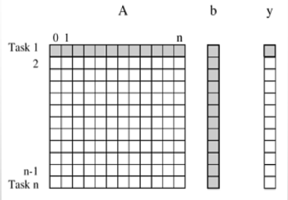
Preliminaries
Decomposition, Tasks, and Dependency Graphs
Figure, Decomposition of dense matrix-vector multiplication into n tasks, where n is the number of rows in the matrix.
The portions of the matrix and the input and output vectors accessed by Task 1 are highlighted.
An abstraction used to express dependencies among tasks and their relative order of execution is known as a task dependency graph.

Slide 109
Preliminaries
Granularity, Concurrency, and Task-Interaction
The number and size of tasks into which a problem is decomposed determines the granularity of the decomposition.
Decomposition into a large number of small tasks is called fine-grained.
Decomposition into a small number of large tasks is called coarse-grained.
A concept related to granularity is that of degree of concurrency.
The maximum number of tasks that can be executed simultaneously in a parallel program at any given time is known as its maximum degree of concurrency.
A feature of a task-dependency graph that determines the average degree of concurrency for a given granularity is its critical path.

Slide 110
Preliminaries
The longest directed path between any pair of start and finish nodes is known as the critical path.
The sum of the weights of nodes along this path is known as the critical path length, where the weight of a node is the size or amount of work associated with corresponding task.
The ratio of the total amount of work to the critical path length is the average degree of concurrency.

Slide 111
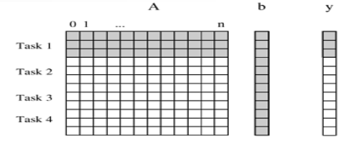
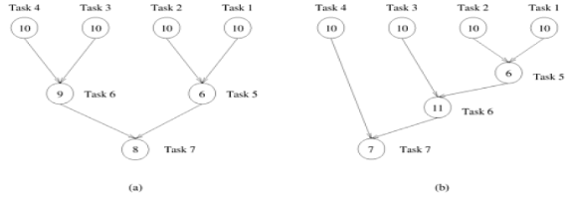
Preliminaries
Figure Decomposition of dense matrix-vector multiplication into four tasks.
The portions of the matrix and the input and output vectors accessed by Task 1 are highlighted.
Figure , Abstractions of the task graphs

Slide 112
CSE3009 - Parallel and Distributed Computing Course Type: LTP Credits: 4
Prepared by
Dr Komarasamy G
Associate Professor (Grade-2)
School of Computing Science and Engineering
VIT Bhopal University

Slide 113
Unit-2
Parallel Algorithm and Design - Preliminaries – Decomposition Techniques – Mapping Techniques for Load balancing.
Synchronous Parallel Processing – Introduction, Example-SIMD Architecture and Programming Principles.

Slide 114
Decomposition Techniques
These techniques are broadly classified as recursive decomposition, data decomposition, exploratory decomposition, and speculative decomposition.
1. Recursive Decomposition
Recursive decomposition is a method for inducing concurrency in problems that can be solved using the divide-and-conquer strategy.
Divide and conquer strategy results in natural concurrency, as different sub problems can be solved concurrently.
Example Quicksort Consider the problem of sorting a sequence A of n elements using the commonly used quicksort algorithm.
Quicksort is a divide and conquer algorithm that starts by selecting a and pivot element x and then partitions the sequence A into two subsequences such that all the elements in are smaller than x and all the elements in are greater than or equal to x.

Slide 115
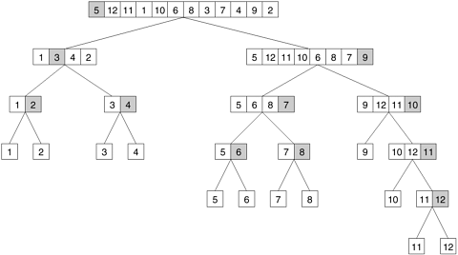
Decomposition Techniques
The partitioning step forms the divide step of the algorithm Each one of the subsequences is sorted by recursively calling quicksort. Each one of these recursive calls further partitions the sequences. This is illustrated in Figure for a sequence of 12 numbers.
The recursion terminates when each subsequence contains only a single element. The quicksort task-dependency graph based on recursive decomposition for sorting a sequence of 12 numbers.

Slide 116
Decomposition Techniques
2. Data Decomposition
Data decomposition is a powerful and commonly used method for deriving concurrency in algorithms that operate on large data structures.
In this method, the decomposition of computations is done in two steps.
In the first step, the data is partitioned on which the computations has performed.
In the second step, this data partitioning is used to induce a partitioning of the computations into tasks.

Slide 117
Decomposition Techniques
3. Partitioning Output Data
In many computations, each element of the output can be computed independently of others as a function of the input.
In such computations, a partitioning of the output data automatically induces a decomposition of the problems into tasks, where each task is assigned the work of computing a portion of the output.

Slide 118
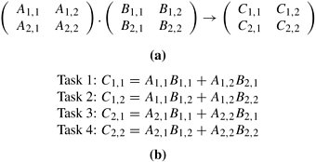
Decomposition Techniques
Example, Matrix multiplication
Consider the problem of multiplying two n x n matrices A and B to yield a matrix C. The four sub matrices of C, roughly of size n/2 x n/2 each, are then independently computed by four tasks as the sums of the appropriate products of sub matrices of A and B.
Figure (a) Partitioning of input and output matrices into 2 x 2 sub matrices. (b) A decomposition of matrix multiplication into four tasks based on the partitioning of the matrices in (a).

Slide 119
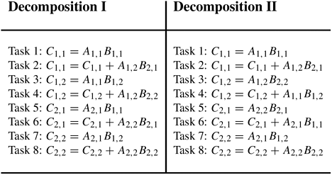
Decomposition Techniques
Two examples of decomposition of matrix multiplication into eight tasks.

Slide 120
Decomposition Techniques
4. Partitioning Input Data
Partitioning of output data can be performed only if each output can be naturally computed as a function of the input.
A task is created for each partition of the input data and this task performs as much computation as possible using these local data.
Figure, some decompositions for computing item set frequencies in a transaction database.

Slide 121
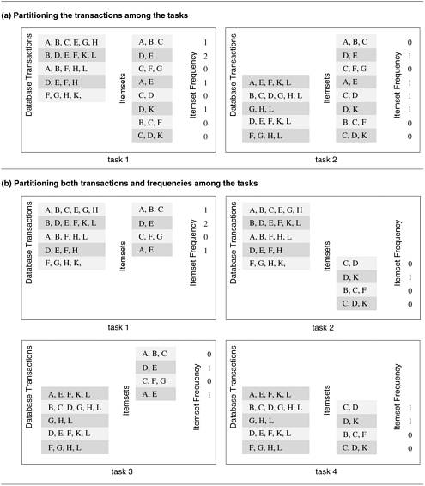
Decomposition Techniques
Partitioning Input Data
Some decompositions for computing item set frequencies in a transaction database.

Slide 122
Decomposition Techniques
Partitioning both Input and Output Data In some cases, in which it is possible to partition the output data, partitioning of input data can offer additional concurrency.
Partitioning intermediate data Partitioning intermediate data can sometimes lead to higher concurrency than partitioning input or output data.
Figure, Multiplication of matrices A and B with partitioning of the three-dimensional intermediate matrix D.

Slide 123
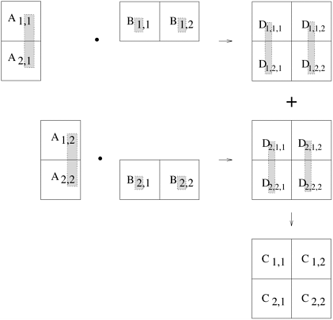
Decomposition Techniques
Multiplication of matrices A and B with partitioning of the three-dimensional intermediate matrix D.

Slide 124
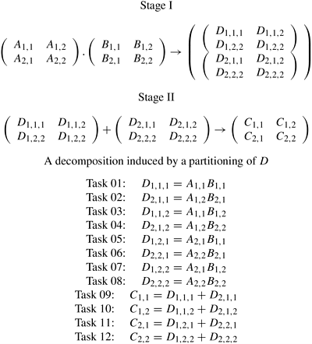
Decomposition Techniques
Figure A decomposition of matrix multiplication based on partitioning the intermediate three-dimensional matrix.
A decomposition of matrix multiplication based on partitioning the intermediate three-dimensional matrix.

Slide 125
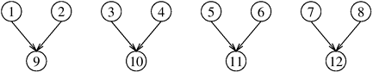
Decomposition Techniques
The task-dependency graph of the decomposition shown in the Figure.

Slide 126
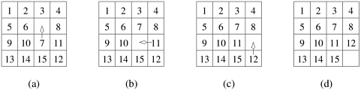
Decomposition Techniques
5. Exploratory Decomposition
Exploratory decomposition is used to decompose problems whose underlying computations correspond to a search of a space for solutions.
In exploratory decomposition, the search space is partitioned into smaller parts, and search each one of these parts concurrently, until the desired solutions are found.
Figure, 15-puzzle problem instance showing the initial configuration (a), the final configuration (d), and a sequence of moves leading from the initial to the final configuration.

Slide 127
Decomposition Techniques
6. Speculative Decomposition
Speculative decomposition is used when a program may take one of many possible computationally significant branches depending on the output of other computations that precede it.
In this situation, while one task is performing the computation whose output is used in deciding the next computation, other tasks can concurrently start the computations of the next stage.
The speedup due to speculative decomposition can add up if there are multiple speculative stages.
An example of an application in which speculative decomposition is useful is discrete event simulation.

Slide 128
Decomposition Techniques
Example Parallel discrete event simulation
Consider the simulation of a system that is represented as a network or a directed graph.
The nodes of this network represent components. Each component has an input buffer of jobs. The initial state of each component or node is idle.
An idle component picks up a job from its input queue, if there is one, processes that job in some finite amount of time, and puts it in the input buffer of the components which are connected to it by outgoing edges.
A component has to wait if the input buffer of one of its outgoing neighbors if full, until that neighbor picks up a job to create space in the buffer. There is a finite number of input job types.

Slide 129
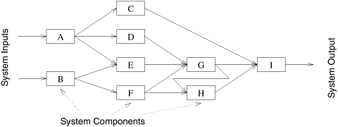
Decomposition Techniques
Example Parallel discrete event simulation
A simple network for discrete event simulation.

Slide 130
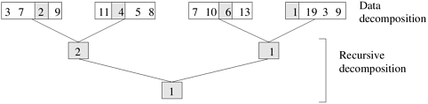
Decomposition Techniques
7. Hybrid Decompositions
A computation is structured into multiple stages and it is sometimes necessary to apply different types of decomposition in different stages.
Figure, Hybrid decomposition for finding the minimum of an array of size 16 using four tasks.
Hybrid decomposition for finding the minimum of an array of size 16 using four tasks.
More details: http://users.atw.hu/parallelcomp/ch03lev1sec2.html

Slide 131
CSE3009 - Parallel and Distributed Computing Course Type: LTP Credits: 4
Prepared by
Dr Komarasamy G
Associate Professor (Grade-2)
School of Computing Science and Engineering
VIT Bhopal University

Slide 132
Unit-2
Parallel Algorithm and Design - Preliminaries – Decomposition Techniques – Mapping Techniques for Load balancing.
Synchronous Parallel Processing – Introduction, Example - SIMD Architecture and Programming Principles.

Slide 133
Mapping Techniques for Load balancing
Once a computation has been decomposed into tasks, these tasks are mapped onto processes with the objective that all tasks complete in the shortest amount of elapsed time.
In order to achieve a small execution time, the overheads of executing the tasks in parallel must be minimized.
For a given decomposition, there are two key sources of overhead. The time spent in inter-process interaction is one source of overhead.
Another important source of overhead is the time that some processes may spend being idle. Some processes can be idle even before the overall computation is finished for a variety of reasons.
Uneven load distribution may cause some processes to finish earlier than others.

Slide 134
Mapping Techniques for Load balancing
At times, all the unfinished tasks mapped onto a process may be waiting for tasks mapped onto other processes to finish in order to satisfy the constraints imposed by the task-dependency graph. Both interaction and idling are often a function of mapping.
Therefore, a good mapping of tasks onto processes must strive to achieve the two objectives.
(1) reducing the amount of time processes spend in interacting with each other.
(2) reducing the total amount of time some processes are idle while the others are engaged in performing some tasks.
These two objectives often conflict with each other.

Slide 135
Mapping Techniques for Load balancing
For example, the objective of minimizing the interactions can be easily achieved by assigning sets of tasks that need to interact with each other onto the same process.
In most cases, such a mapping will result in a highly unbalanced workload among the processes.
In fact, following this strategy to the limit will often map all tasks onto a single process.
As a result, the processes with a lighter load will be idle when those with a heavier load are trying to finish their tasks.
Similarly, to balance the load among processes, it may be necessary to assign tasks that interact heavily to different processes.
Due to the conflicts between these objectives, finding a good mapping is a nontrivial problem.

Slide 136
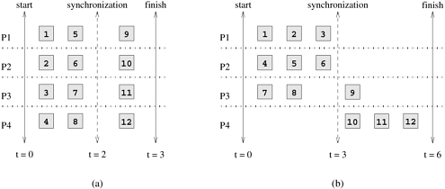
Mapping Techniques for Load balancing
Figure, shows two mappings of 12-task decomposition in which the last four tasks can be started only after the first eight are finished due to dependencies among tasks. As the figure shows, two mappings, each with an overall balanced workload, can result in different completion times.
Two mappings of a hypothetical decomposition with a synchronization.

Slide 137
Mapping Techniques for Load balancing
Mapping techniques used in parallel algorithms can be broadly classified into two categories: static and dynamic.
The parallel programming paradigm and the characteristics of tasks and the interactions among them determine whether a static or a dynamic mapping is more suitable.
Static Mapping: Static mapping techniques distribute the tasks among processes prior to the execution of the algorithm.
For statically generated tasks, either static or dynamic mapping can be used.
The choice of a good mapping in this case depends on several factors, including the knowledge of task sizes, the size of data associated with tasks, the characteristics of inter-task interactions, and even the parallel programming paradigm.

Slide 138
Mapping Techniques for Load balancing
Dynamic Mapping: Dynamic mapping techniques distribute the work among processes during the execution of the algorithm.
If tasks are generated dynamically, then they must be mapped dynamically too. If task sizes are unknown, then a static mapping can potentially lead to serious load-imbalances and dynamic mappings are usually more effective.
If the amount of data associated with tasks is large relative to the computation, then a dynamic mapping may entail moving this data among processes.
The cost of this data movement may outweigh some other advantages of dynamic mapping and may render a static mapping more suitable. However, in a shared-address-space paradigm, dynamic mapping may work well even with large data associated with tasks if the interaction is read-only.

Slide 139
Mapping Techniques for Load balancing
Schemes for Static Mapping
Static mapping is often, though not exclusively, used in conjunction with a decomposition based on data partitioning.
Static mapping is also used for mapping certain problems that are expressed naturally by a static task-dependency graph.
In the following subsections, we will discuss mapping schemes based on data partitioning and task partitioning.
Mappings Based on Data Partitioning
Mappings based on partitioning two of the most common ways of representing data in algorithms, namely, arrays and graphs.
The data-partitioning actually induces a decomposition, but the partitioning or the decomposition is selected with the final mapping in mind.

Slide 140
Mapping Techniques for Load balancing
Array Distribution Schemes
In a decomposition based on partitioning data, the tasks are closely associated with portions of data by the owner-computes rule.
Therefore, mapping the relevant data onto the processes is equivalent to mapping tasks onto processes.
We now study some commonly used techniques of distributing arrays or matrices among processes.

Slide 141
Mapping Techniques for Load balancing
Block Distributions
Block distributions are some of the simplest ways to distribute an array and assign uniform contiguous portions of the array to different processes.
In these distributions, a d-dimensional array is distributed among the processes such that each process receives a contiguous block of array entries along a specified subset of array dimensions.
Block distributions of arrays are particularly suitable when there is a locality of interaction,
i.e., computation of an element of an array requires other nearby elements in the array.

Slide 142
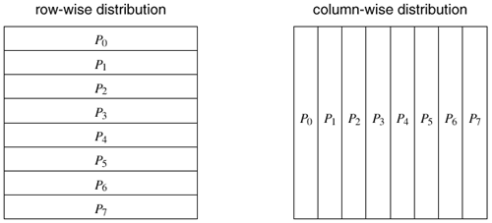
Mapping Techniques for Load balancing
For example, consider an n x n two-dimensional array A with n rows and n columns. We can now select one of these dimensions, e.g., the first dimension, and partition the array into p parts such that the kth part contains rows kn /p...(k + 1)n/p - 1, where 0≤ k < p.
That is, each partition contains a block of n/p consecutive rows of A. Similarly, if we partition A along the second dimension, then each partition contains a block of n/p consecutive columns.
These row- and column-wise array distributions are illustrated in Figure
Examples of one-dimensional partitioning of an array among eight processes.

Slide 143
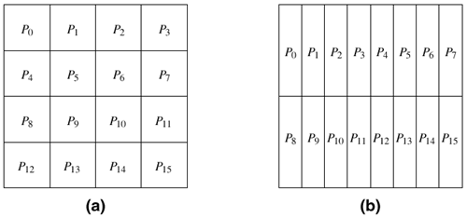
Mapping Techniques for Load balancing
instead of selecting a single dimension, we can select multiple dimensions to partition. For instance, in the case of array A we can select both dimensions and partition the matrix into blocks such that each block corresponds to a n/p1 x n/p2 section of the matrix, with p = p1 x p2 being the number of processes. Figure illustrates two different two-dimensional distributions, on a 4 x 4 and 2x 8 process grid, respectively. In general, given a d-dimensional array, we can distribute it using up to a d-dimensional block distribution.
Examples of two-dimensional distributions of an array,
(a) on a 4 x 4 process grid, and (b) on a 2 x 8 process grid.

Slide 144
Mapping Techniques for Load balancing
Cyclic and Block-Cyclic Distributions
If the amount of work differs for different elements of a matrix, a block distribution can potentially lead to load imbalances.
A classic example of this phenomenon is LU (lower–upper) factorization of a matrix, in which the amount of computation increases from the top left to the bottom right of the matrix.
The LU factorization algorithm factors a nonsingular square matrix A into the product of a lower triangular matrix L with a unit diagonal and an upper triangular matrix U.

Slide 145
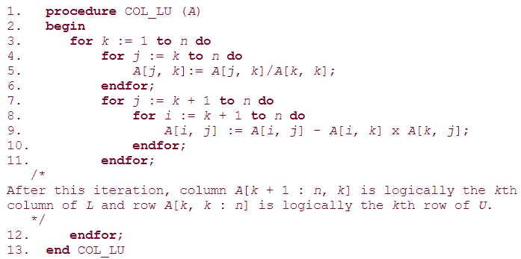
Mapping Techniques for Load balancing
Algorithm, A serial column-based algorithm to factor a nonsingular matrix A into a lower triangular matrix L and an upper-triangular matrix U.
Matrices L and U share space with A. On Line 9, A[i, j] on the left side of the assignment is equivalent to L [i, j] if i > j; otherwise, it is equivalent to U [i, j].

Slide 146
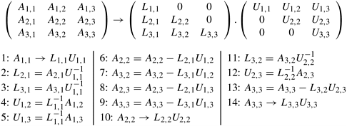

Mapping Techniques for Load balancing
A decomposition of LU factorization into 14 tasks.
A typical computation in Gaussian elimination and the active part of the coefficient matrix during the kth iteration of the outer loop.

Slide 147

Mapping Techniques for Load balancing
A naive mapping of LU factorization tasks onto processes based on a two-dimensional block distribution.
The block-cyclic distribution is a variation of the block distribution scheme that can be used to the load-imbalance and idling problems.
A detailed description of LU factorization with block-cyclic mapping , where it is shown how a block-cyclic mapping leads to a substantially more balanced work distribution than in above Figure

Slide 148

Mapping Techniques for Load balancing
Examples of one- and two-dimensional block-cyclic distributions among four processes. (a) The rows of the array are grouped into blocks each consisting of two rows, resulting in eight blocks of rows. These blocks are distributed to four processes in a wraparound fashion. (b) The matrix is blocked into 16 blocks each of size 4 x 4, and it is mapped onto a 2 x 2 grid of processes in a wraparound fashion.

Slide 149
Mapping Techniques for Load balancing
The reason why a block-cyclic distribution is able to significantly reduce the amount of idling is that all processes have a sampling of tasks from all parts of the matrix.
As a result, even if different parts of the matrix require different amounts of work, the overall work on each process balances out.
Also, since the tasks assigned to a process belong to different parts of the matrix, there is a good chance that at least some of them are ready for execution at any given time.

Slide 150
Mapping Techniques for Load balancing
Randomized Block Distributions
A block-cyclic distribution may not always be able to balance computations when the distribution of work has some special patterns.
For example, consider the sparse matrix shown in Figure in which the shaded areas correspond to regions containing nonzero elements.
If this matrix is distributed using a two-dimensional block-cyclic distribution, as illustrated in Figure then we will end up assigning more non-zero blocks to the diagonal processes P0, P5, P10, and P15 than on any other processes.
In fact some processes, like P12, will not get any work.

Slide 151

Mapping Techniques for Load balancing
Using the block-cyclic distribution shown in (b) to distribute the computations performed in array (a) will lead to load imbalances.
Randomized block distribution, a more general form of the block distribution, can be used in situations illustrated in Figure. Just like a block-cyclic distribution, load balance is sought by partitioning the array into many more blocks than the number of available processes.

Slide 152

Mapping Techniques for Load balancing
A one-dimensional randomized block mapping of 12 blocks onto four process (i.e., a = 3).

Slide 153

Mapping Techniques for Load balancing
Using a two-dimensional random block distribution shown in (b) to distribute the computations performed in array (a), as shown in (c).

Slide 154
Mapping Techniques for Load balancing
Graph Partitioning
The array-based distribution schemes that we described so far are quite effective in balancing the computations and minimizing the interactions for a wide range of algorithms that use dense matrices and have structured and regular interaction patterns. However, there are many algorithms that operate on sparse data structures and for which the pattern of interaction among data elements is data dependent and highly irregular.
Numerical simulations of physical phenomena provide a large source of such type of computations. In these computations, the physical domain is discretized and represented by a mesh of elements.
The simulation of the physical phenomenon being modeled then involves computing the values of certain physical quantities at each mesh point. The computation at a mesh point usually requires data corresponding to that mesh point and to the points that are adjacent to it in the mesh.

Slide 155

Mapping Techniques for Load balancing
For example, Figure shows a mesh imposed on Lake Superior. The simulation of a physical phenomenon such the dispersion of a water contaminant in the lake would now involve computing the level of contamination at each vertex of this mesh at various intervals of time.
A mesh used to model Lake Superior.

Slide 156

Mapping Techniques for Load balancing
the amount of computation at each point is the same, the load can be easily balanced by simply assigning the same number of mesh points to each process. However, if a distribution of the mesh points to processes does not strive to keep nearby mesh points together, then it may lead to high interaction overheads due to excessive data sharing.
For example, if each process receives a random set of points as illustrated in Figure, then each process will need to access a large set of points belonging to other processes to complete computations for its assigned portion of the mesh.
A random distribution of the mesh elements to eight processes.

Slide 157

Mapping Techniques for Load balancing
Distribute the mesh points in a way that balances the load and at the same time minimizes the amount of data that each process needs to access in order to complete its computations.
Partition the mesh into p parts such that each part contains roughly the same number of mesh-points or vertices, and the number of edges that cross partition boundaries is minimized. After partitioning the mesh, each one of these p partitions is assigned to one of the p processes.
Each process is assigned a contiguous region of the mesh such that the total number of mesh points that needs to be accessed across partition boundaries is minimized.
A distribution of the mesh elements to eight processes, by using a graph-partitioning algorithm.

Slide 158

Mapping Techniques for Load balancing
Mappings Based on Task Partitioning
A mapping based on partitioning a task-dependency graph and mapping its nodes onto processes can be used when the computation is naturally expressible in the form of a static task-dependency graph with tasks of known sizes. As usual, this mapping must seek to achieve the often conflicting objectives of minimizing idle time and minimizing the interaction time of the parallel algorithm. Determining an optimal mapping for a general task-dependency graph is an NP-complete problem. However, specific situations often lend themselves to a simpler optimal or acceptable approximate solution.
Mapping of a binary tree task-dependency graph onto a hypercube of processes.

Slide 159


Mapping Techniques for Load balancing
A mapping for sparse matrix-vector multiplication onto three processes. The list Ci contains the indices of b that Process i needs to access from other processes.
Reducing interaction overhead in sparse matrix-vector multiplication by partitioning the task-interaction graph.

Slide 160
Mapping Techniques for Load balancing
Hierarchical Mappings
Certain algorithms are naturally expressed as task-dependency graphs;
However, a mapping based solely on the task-dependency graph may suffer from load-imbalance or inadequate concurrency. For example, in the binary-tree task-dependency graph of Figure, only a few tasks are available for concurrent execution in the top part of the tree. If the tasks are large enough, then a better mapping can be obtained by a further decomposition of the tasks into smaller subtasks.
In the case where the task-dependency graph is a binary tree with four levels, the root task can be partitioned among eight processes, the tasks at the next level can be partitioned among four processes each, followed by tasks partitioned among two processes each at the next level.
The eight leaf tasks can have a one-to-one mapping onto the processes.
Figure, illustrates such a hierarchical mapping. Parallel quicksort introduced in Example has a task-dependency graph similar to the one shown in Figure, and hence is an ideal candidate for a hierarchical mapping of the type shown in Figure.

Slide 161

Mapping Techniques for Load balancing
An example of hierarchical mapping of a task-dependency graph. Each node represented by an array is a supertask. The partitioning of the arrays represents subtasks, which are mapped onto eight processes.

Slide 162
Mapping Techniques for Load balancing
Schemes for Dynamic Mapping
Dynamic mapping is necessary in situations where a static mapping may result in a highly imbalanced distribution of work among processes or where the task-dependency graph itself if dynamic, thus precluding a static mapping.
Since the primary reason for using a dynamic mapping is balancing the workload among processes, dynamic mapping is often referred to as dynamic load-balancing.
Dynamic mapping techniques are usually classified as either
Centralized
Distributed

Slide 163
Mapping Techniques for Load balancing
1. Centralized Schemes
All executable tasks are maintained in a common central data structure or they are maintained by a special process or a subset of processes.
If a special process is designated to manage the pool of available tasks, then it is often referred to as the master and the other processes that depend on the master to obtain work are referred to as slaves.
Whenever a process has no work, it takes a portion of available work from the central data structure or the master process. Whenever a new task is generated, it is added to this centralized data structure or reported to the master process.
Centralized load-balancing schemes are usually easier to implement than distributed schemes, but may have limited scalability.
As more and more processes are used, the large number of accesses to the common data structure or the master process tends to become a bottleneck.

Slide 164
Mapping Techniques for Load balancing
2. Distributed Schemes
In a distributed dynamic load balancing scheme, the set of executable tasks are distributed among processes which exchange tasks at run time to balance work. Each process can send work to or receive work from any other process. These methods do not suffer from the bottleneck associated with the centralized schemes.
Some of the critical parameters of a distributed load balancing scheme are as follows:
How are the sending and receiving processes paired together?
Is the work transfer initiated by the sender or the receiver?
How much work is transferred in each exchange? If too little work is transferred, then the receiver may not receive enough work and frequent transfers resulting in excessive interaction may be required.
When is the work transfer performed?
For example, in receiver initiated load balancing, work may be requested when the process has actually run out of work or when the receiver has too little work left and anticipates being out of work soon.

Slide 165
Mapping Techniques for Load balancing
More details
http://users.atw.hu/parallelcomp/ch03lev1sec4.html

Slide 166
CSE3009 - Parallel and Distributed Computing Course Type: LTP Credits: 4
Prepared by
Dr Komarasamy G
Senior Associate Professor
School of Computing Science and Engineering
VIT Bhopal University

Slide 167
Unit-2
Parallel Algorithm and Design - Preliminaries – Decomposition Techniques – Mapping Techniques for Load balancing.
Synchronous Parallel Processing – Introduction, Example - SIMD Architecture and Programming Principles.

Slide 168
Synchronous Parallel Processing
Parallel Computing :
It is the use of multiple processing elements simultaneously for solving any problem.
Problems are broken down into instructions and are solved concurrently as each resource that has been applied to work is working at the same time.
Advantages of Parallel Computing over Serial Computing are as follows:
It saves time and money as many resources working together will reduce the time and cut potential costs.
It can be impractical to solve larger problems on Serial Computing.
It can take advantage of non-local resources when the local resources are finite.
Serial Computing ‘wastes’ the potential computing power, thus Parallel Computing makes better work of the hardware.

Slide 169
Synchronous Parallel Processing
Why parallel computing?
The whole real-world runs in dynamic nature i.e. many things happen at a certain time but at different places concurrently.
This data is extensively huge to manage.
Real-world data needs more dynamic simulation and modeling, and for achieving the same, parallel computing is the key.
Parallel computing provides concurrency and saves time and money.
Complex, large datasets, and their management can be organized only and only using parallel computing approach.
Ensures the effective utilization of the resources. The hardware is guaranteed to be used effectively whereas in serial computation only some part of the hardware was used and the rest rendered idle.
Also, it is impractical to implement real-time systems using serial computing.

Slide 170


Synchronous Parallel Processing

Slide 171
Synchronous Parallel Processing
Parallel Processing
Parallel processing can be described as a class of techniques which enables the system to achieve simultaneous data-processing tasks to increase the computational speed of a computer system.
A parallel processing system can carry out simultaneous data-processing to achieve faster execution time.
For instance, while an instruction is being processed in the ALU component of the CPU, the next instruction can be read from memory.
The primary purpose of parallel processing is to enhance the computer processing capability and increase its throughput, i.e. the amount of processing that can be accomplished during a given interval of time.

Slide 172
Synchronous Parallel Processing
A parallel processing system can be achieved by having a multiplicity of functional units that perform identical or different operations simultaneously.
The data can be distributed among various multiple functional units.
The diagram shows one possible way of separating the execution unit into eight functional units operating in parallel.

Slide 173

Synchronous Parallel Processing
Parallel Processing

Slide 174
Synchronous Parallel Processing
The adder and integer multiplier performs the arithmetic operation with integer numbers.
The floating-point operations are separated into three circuits operating in parallel.
The logic, shift, and increment operations can be performed concurrently on different data.
All units are independent of each other, so one number can be shifted while another number is being incremented.

Slide 175


Introduction about SIMD

Slide 176

Introduction about SIMD
Vector Supercomputers

Slide 177
Introduction about SIMD
Multivector and SIMD Computers
Supercomputers and parallel processors for vector processing and data parallelism.
Vector Supercomputers
In a vector computer, a vector processor is attached to the scalar processor as an optional feature.
The host computer first loads program and data to the main memory. Then the scalar control unit decodes all the instructions.
If the decoded instructions are scalar operations or program operations, the scalar processor executes those operations using scalar functional pipelines.
On the other hand, if the decoded instructions are vector operations then the instructions will be sent to vector control unit.

Slide 178

Introduction about SIMD
SIMD Supercomputers
In SIMD computers, ‘N’ number of processors are connected to a control unit and all the processors have their individual memory units. All the processors are connected by an interconnection network.

Slide 179

SIMD Architecture (Single instruction Multiple Data)
Single instruction is applied to a multiple data item to produce the same output.
Master instruction work on vector of operand.
No of processors running the same instruction one clock cycle by the strict lock approach.
It is type of Instruction level parallelism
Communication network allow parallel synchronous communication between several Processing Element / Memory modules.
SIMD Processor Architecture

Slide 180

SIMD Architecture (Single instruction Multiple Data)
Following two SIMD architectures depict fundamentally different approaches to the parallel processing
Data Communication based on message passing paradigm:
Here the memory is part of PE and thus it communicates through the interconnection network for passing the data.

Slide 181

SIMD Architecture (Single instruction Multiple Data)
Shared memory between processors:
Here memories are not local and the data is read and aligned by the alignment network that aligns the data between PEs and Memory modules

Slide 182
SIMD Architecture (Single instruction Multiple Data)
SIMD Parallel Process:
During the execution of program, it is often required to mask of a PE from doing processing, which is equivalent to having some autonomous control within a PE.
PE has a mask bit which can be masked during processing of an instruction.
When a mask in PE is set it receives instruction from Control Unit as No operation.
Executes instruction when mask bit is reset.
Each PE has one or more index registers added to global addresses supplied by the CU Instruction.
The arithmetic logic unit has few general purpose registers and pointer registers to support data and address manipulation.

Slide 183
SIMD Architecture (Single instruction Multiple Data)
SIMD mesh connected architecture:
Here we are dealing with the mesh Connected architecture which has been built using the mesh connected architecture.
Each node of such machine will have four ports- Top port, left port, right port and bottom port.
The instruction set belongs to CU with PEs executing some of instructions that are prefixed with P to indicate that these shall be executed on PEs in parallel.
Each PE also has four bidirectional ports for communication to four neighbors.

Slide 184
Programming Principles
Programming style refers to the technique used in writing the source code for a computer program.
Most programming styles are designed to help programmers quickly read and understands the program as well as avoid making errors. (Older programming styles also focused on conserving screen space.)
A good coding style can overcome the many deficiencies of a first programming language, while poor style can defeat the intent of an excellent language.
The goal of good programming style is to provide understandable, straightforward, elegant code.
The programming style used in a various program may be derived from the coding standards or code conventions of a company or other computing organization, as well as the preferences of the actual programmer.

Slide 185

Programming Principles
Some general rules or guidelines in respect of programming style:

Slide 186
Programming Principles
1. Clarity and simplicity of Expression: The programs should be designed in such a manner so that the objectives of the program is clear.
2. Naming: In a program, you are required to name the module, processes, and variable, and so on. Care should be taken that the naming style should not be cryptic and non-representative.
For Example: a = 3.14 * r * r area of circle = 3.14 * radius * radius;
3. Control Constructs: It is desirable that as much as a possible single entry and single exit constructs used.
4. Information hiding: The information secure in the data structures should be hidden from the rest of the system where possible. Information hiding can decrease the coupling between modules and make the system more maintainable.

Slide 187
Programming Principles
5. Nesting: Deep nesting of loops and conditions greatly harm the static and dynamic behavior of a program. It also becomes difficult to understand the program logic, so it is desirable to avoid deep nesting.
6. User-defined types: Make heavy use of user-defined data types like enum, class, structure, and union. These data types make your program code easy to write and easy to understand.
7. Module size: The module size should be uniform. The size of the module should not be too big or too small. If the module size is too large, it is not generally functionally cohesive. If the module size is too small, it leads to unnecessary overheads.
8. Module Interface: A module with a complex interface should be carefully examined.
9. Side-effects: When a module is invoked, it sometimes has a side effect of modifying the program state. Such side-effect should be avoided where as possible.

Slide 188
Common Programming Principles
Programming principles are guidelines and best practices that help developers write clean, maintainable, and efficient code. Here are 7 common programming principles
KISS (Keep It Simple, Stupid)
DRY (Don’t Repeat Yourself )
YAGNI (You Aren’t Gonna Need It )
SOLID
Separation of Concerns (SoC)
Avoid Premature Optimization
Law of Demeter

Slide 189
Common Programming Principles
1. KISS (Keep It Simple, Stupid)
Nobody in programming loves to debug, maintain, or make changes in complex code. It is very first principle, acronym stands for Keep It Simple, Stupid. The other famous alternate acronyms are
Each unit should have only limited knowledge about other units: only units “closely” related to the current unit.
Each unit should only talk to its friends; don’t talk to strangers.
“Keep It Simple, Stupid (KISS)“ states that most systems work best if they are kept simple rather than making it complex, so when you are writing code your solution should not be complicated that takes a lot of time and effort to understand. If your code is simple then other developers won’t face any problem understanding the code logic and they can easily proceed further with your code.
Example of KISS (Keep It Simple, Stupid)
function mul ( a, b ) { return a*b }

Slide 190
Common Programming Principles
2. DRY (Don’t Repeat Yourself )
Duplication of data, logic, or function in code not only makes your code lengthy but also wastes a lot of time when it comes to maintaining, debug or modify the code. If you need to make a small change in your code then you need to do it at several places.
“Don’t Repeat Yourself (DRY)” principal goal is to reduce the repetition of code. It states that a piece of code should be implemented in just one place in the source code.
The opposite of the DRY principle is WET (“write everything twice” or “waste everyone’s time”) which breaks the DRY principle if you are writing the same logic at several places.
You can create a common function or abstract your code to avoid the repetition in your code.

Slide 191
Common Programming Principles
Example of DRY (Don’t Repeat Yourself )
//Convert Two Temperatures From Fahrenheit to Celsius before applying DRY principal input far1 from user input far2 from user calculate cel1 = (fah1-32) *5/9 calculate cel2= (fah2-32)*5/9 print cel1 print cel2 //Convert Two Temperatures From Fahrenheit to Celsius after applying DRY principal input far1 from user input far2 from user calculate cel1 = cal ( f1) calculate cel2= cal (f2) print cel1 print cel2 function cal ( fah ) { cel= (fah1-32) *5/9 return cel }

Slide 192
Common Programming Principles
3. YAGNI (You Aren’t Gonna Need It )
Your software or program can become larger and complex if you are writing some code which you may need in the future but not at the moment.
“You Aren’t Gonna Need It (YAGNI)” principle states that “don’t implement something until it is necessary” because in most of the cases you are not going to use that piece of code in future.
Most of the programmers while implementing software think about the future possibility and add some code or logic for some other features which they don’t need at present.
They add all the unnecessary class and functionality which they might never use in the future. Doing this is completely wrong and you will eventually end up in writing bloated code also your project becomes complicated and difficult to maintain.
We recommend all the programmers to avoid this mistake to save a lot of time and effort.

Slide 193
Common Programming Principles
Example of YAGNI
// If Programmer asked to write a Program to add 7 and 3 function (x,y){ return x+y }
instead of this write what you have to told function ( 7, 3 ){ return 7+3 }

Slide 194

Common Programming Principles
4. SOLID
The SOLID principle stands for five principles which are Single responsibility, Open-closed, Liskov substitution, Interface Segregation, and Dependency inversion.
These principles are given by Robert C. Martin and you can check about these SOLID principle in detail.
This principle is an acronym of the five principles which is given below.
Single Responsibility Principle (SRP)
Open/Closed Principle
Liskov’s Substitution Principle (LSP)
Interface Segregation Principle (ISP)
Dependency Inversion Principle (DIP)

Slide 195
Common Programming Principles
5. Separation of Concerns (SoC):
Separation of Concerns Principle partition a complicated application into different sections or domains. Each section or domain addresses a separate concern or has a specific job.
Each section is independent of each other and that’s why each section can be tackled independently also it becomes easier to maintain, update, and reuse the code.
Example of SOC
business logic (the content of the webpage) in an application is a different concern and user interface is a different concern in a web application program.
One of the good examples of SoC is the MVC pattern where data (“model”), the logic (“controller”), and what the end-user sees (“view”) divided into three different sections and each part is handled independently. Saving of data to a database has nothing to do with rendering the data on the web.

Slide 196

Common Programming Principles
5. Separation of Concerns (SoC):

Slide 197
Common Programming Principles
6. Avoid Premature Optimization
Optimization indeed helps in speeding up the program or algorithm but according to this principle you don’t need to optimize your algorithm at an early stage of development.
If you do premature optimization you won’t be able to know where a program’s bottlenecks will be and maintenance will become harder for you.
If you optimize your code in the beginning and case if the requirement may change than your efforts will be wasted and your code will go to the garbage.
So it’s better to optimize the algorithm at the right time to get the right benefit of it.
Premature optimization is the root of all evil in programming. –Donald Knuth

Slide 198
Common Programming Principles
7. Law of Demeter
This principle was first introduced by Ian Holland in 1987 at Northeastern University.
It is also known as the principle of least knowledge.
This principle divides the responsibility between classes or different units and it can be summarized in three points.
Each unit should have only limited knowledge about other units: only units “closely” related to the current unit.
Each unit should only talk to its friends; don’t talk to stranger (not familiar person).
Only talk to your immediate friends.

Slide 199

Common Programming Principles
7. Law of Demeter
The Law of Demeter helps in maintaining independent classes and makes your code less which is very important in software development to make your application flexible, stable, maintainable and understandable.

Slide 200
More details
https://pubhtml5.com/kcvf/ptcf/basic/51-100
https://www.geeksforgeeks.org/7-common-programming-principles-that-every-developer-must-follow/

Slide 201
CSE3009 - Parallel and Distributed Computing Course Type: LTP Credits: 4
Prepared by
Dr Komarasamy G
Associate Professor (Grade-2)
School of Computing Science and Engineering
VIT Bhopal University

Slide 202
Unit-3
Introduction to Distributed Systems – Definition, Issues, Goals, Types of distributed systems, Distributed System Models, Hardware concepts, Software Concept, Design Issues.
Communication – Layered Protocols, Remote Procedure Call, Remote Object Invocation, Message Oriented Communication, Stream Oriented Communication – Case Study (RPC and Java RMI).
Parallel Random Access Machine (PRAM) model, PRAM architecture.

Slide 203

Introduction to Distributed Systems
Distributed System is a Network of Machines that can exchange information with each other through Message-passing.
It can be very useful as it helps in resource sharing. It enables computers to coordinate their activities and to share the resources of the system so that users perceive the system as a single, integrated computing facility.

Slide 204
Types of Distributed Systems
Client/Server Systems
Peer-to-Peer Systems
Middleware
Three-tier
N-tier
1. Client/Server Systems:
Client-Server System is the most basic communication method where the client sends input to the server and the server replies to the client with an output.
The client requests the server for resources or a task to do, the server allocates the resource or performs the task and sends the result in the form of a response to the request of the client. Client Server System can be applied with multiple servers.

Slide 205
Types of Distributed Systems
2. Peer-to-Peer Systems: Peer-to-Peer System communication model works as a decentralized model in which the system works like both Client and Server. Nodes are an important part of a system.
In this, each node performs its task on its local memory and shares data through the supporting medium, this node can work as a server or as a client for a system.
Programs in the peer-to-peer system can communicate at the same level without any hierarchy.
3. Middleware: Middleware can be thought as an application that sits between two separate applications and provides service to both. It works as a base for different interoperability applications running on different operating systems. Data can be transferred to other between others by using this service.

Slide 206
Types of Distributed Systems
4. Three-tier: Three-tier system uses a separate layer and server for each function of a program.
In this data of the client is stored in the middle tier rather than sorted into the client system or on their server through which development can be done easily.
It includes an Application Layer, Data Layer, and Presentation Layer. This is mostly used in web or online applications.
5. N-tier: N-tier is also called a multitier distributed system. The N-tier system can contain any number of functions in the network.
N-tier systems contain similar structures to three-tier architecture. When interoperability sends the request to another application to perform a task or to provide a service. N-tier is commonly used in web applications and data systems.

Slide 207
Types of Distributed Systems
Characteristics of Distributed System
Resource Sharing: It is the ability to use any Hardware, Software, or Data anywhere in the System.
Concurrency: It is naturally present in Distributed Systems, that deal with the same activity or functionality that can be performed by separate users who are in remote locations. Every local system has its independent Operating Systems and Resources.
Scalability: It increases the scale of the system as several processors communicate with more users by accommodating to improve the responsiveness of the system.
Transparency: It hides the complexity of the Distributed Systems from the Users and Application programs as there should be privacy in every system.

Slide 208
Types of Distributed Systems
Challenges of Distributed Systems
Network latency: The communication network in a distributed system can introduce latency, which can affect the performance of the system.
Distributed coordination: Distributed systems require coordination among the nodes, which can be challenging because of the distributed nature of the system.
Data consistency: Maintaining data consistency across multiple nodes in a distributed system can be challenging.

Slide 209
Distributed System Models
Distributed computing refers to a system where processing and data storage is distributed across multiple devices or systems, rather than being handled by a single central device.
Types of Distributed Computing System Models
Physical Model
A physical model is basically a representation of the underlying hardware elements of a distributed system. It encompasses the hardware composition of a distributed system in terms of computers and other devices and their interconnections. It is primarily used to design, manage, implement and determine the performance of a distributed system. A physical model majorly consists of the following components:

Slide 210
Distributed System Models
Nodes – Nodes are the end devices that have the ability of processing data, executing tasks and communicating with the other nodes.
These end devices are generally the computers at the user end or can be servers, workstations etc.
Nodes provision the distributed system with an interface in the presentation layer that enables the user to interact with other back-end devices, or nodes, that can be used for storage and database services, or processing, web browsing etc.
Each node has an Operating System, execution environment and different middleware requirements that facilitate communication and other vital tasks.

Slide 211
Distributed System Models
Links – Links are the communication channels between different nodes and intermediate devices. These may be wired or wireless.
Wired links or physical media are implemented using copper wires, fibre optic cables etc. The choice of the medium depends on the environmental conditions and the requirements.
Generally, physical links are required for high performance and real-time computing. Different connection types that can be implemented are as follows:
Point-to-point links – It establishes a connection and allows data transfer between only two nodes.
Broadcast links – It enables a single node to transmit data to multiple nodes simultaneously.
Multi-Access links – Multiple nodes share the same communication channel to transfer data. Requires protocols to avoid interference while transmission.

Slide 212
Distributed System Models
Middleware – These are the software's installed and executed on the nodes. By running middleware on each node, the distributed computing system achieves a decentralized control and decision-making.
It handles various tasks like communication with other nodes, resource management, fault tolerance, synchronization of different nodes and security to prevent malicious and unauthorized access.
Network Topology – This defines the arrangement of nodes and links in the distributed computing system.
The most common network topologies that are implemented are bus, star, mesh, ring or hybrid.
Choice of topology is done by determining the exact use cases and the requirements.

Slide 213

Distributed System Models
Communication Protocols – Communication protocols are the set rules and procedures for transmitting data from in the links. Examples of these protocols include TCP, UDP, HTTPS, MQTT etc. These allow the nodes to communicate and interpret the data.

Slide 214
Distributed System Models
Architectural Model - Architectural model in distributed computing system is the overall design and structure of the system, and how its different components are organized to interact with each other and provide the desired functionalities.
It is an overview of the system, on how will the development, deployment and operations take place. Construction of a good architectural model is required for efficient cost usage, and highly improved scalability of the applications. The key aspects of architectural model are –
Client-Server model – It is a centralized approach in which the clients initiate requests for services and severs respond by providing those services. It mainly works on the request-response model where the client sends a request to the server and the server processes it, and responds to the client accordingly. It can be achieved by using TCP/IP, HTTP protocols on the transport layer. This is mainly used in web services, cloud computing, database management systems etc.

Slide 215

Distributed System Models
Client-Server model

Slide 216

Distributed System Models
Peer-to-peer model – It is a decentralized approach in which all the distributed computing nodes, known as peers, are all the same in terms of computing capabilities and can both request as well as provide services to other peers. It is a highly scalable model because the peers can join and leave the system dynamically, which makes it an ad-hoc form of network. The resources are distributed and the peers need to look out for the required resources as and when required. The communication is directly done amongst the peers without any intermediaries according to some set rules and procedures defined in the P2P networks. The best example of this type of computing is BitTorrent.

Slide 217

Distributed System Models
Layered model – It involves organizing the system into multiple layers, where each layer will provision a specific service. Each layer communicated with the adjacent layers using certain well-defined protocols without affecting the integrity of the system. A hierarchical structure is obtained where each layer abstracts the underlying complexity of lower layers.

Slide 218
Distributed System Models
Micro-services model – In this system, a complex application or task, is decomposed into multiple independent tasks and these services running on different servers.
Each service performs only a single function and is focused on a specific business-capability.
This makes the overall system more maintainable, scalable and easier to understand.
Services can be independently developed, deployed and scaled without affecting the ongoing services.

Slide 219

Distributed System Models
Micro-services model

Slide 220
Distributed System Models
Fundamental Model
The fundamental model in a distributed computing system is a broad conceptual framework that helps in understanding the key aspects of the distributed systems.
These are concerned with more formal description of properties that are generally common in all architectural models.
It represents the essential components that are required to understand a distributed system’s behavior.
Three fundamental models are as follows:
Interaction Model – Distributed computing systems are full of many processes interacting with each other in highly complex ways.
Interaction model provides a framework to understand the mechanisms and patterns that are used for communication and coordination among various processes.

Slide 221
Distributed System Models
Different components that are important in this model are –
Message Passing – It deals with passing messages that may contain, data, instructions, a service request, or process synchronization between different computing nodes. It may be synchronous or asynchronous depending on the types of tasks and processes.
Publish/Subscribe Systems – Also known as pub/sub system. In this the publishing process can publish a message over a topic and the processes that are subscribed to that topic can take it up and execute the process for themselves. It is more important in an event-driven architecture.

Slide 222
Distributed System Models
Remote Procedure Call (RPC) – It is a communication paradigm that has an ability to invoke a new process or a method on a remote process as if it were a local procedure call.
The client process makes a procedure call using RPC and then the message is passed to the required server process using communication protocols.
These message passing protocols are abstracted and the result once obtained from the server process, is sent back to the client process to continue execution.

Slide 223

Distributed System Models
Remote Procedure Call (RPC)

Slide 224
Distributed System Models
Failure Model – This model addresses the faults and failures that occur in the distributed computing system. It provides a framework to identify and rectify the faults that occur or may occur in the system.
Fault tolerance mechanisms are implemented so as to handle failures by replication and error detection and recovery methods.
Different failures that may occur are:
Crash failures – A process or node unexpectedly stops functioning.
Omission failures – It involves a loss of message, resulting in absence of required communication.
Timing failures – The process deviates from its expected time quantum and may lead to delays or unsynchronized response times.
Byzantine failures – The process may send malicious or unexpected messages that conflict with the set protocols.

Slide 225
Distributed System Models
Security Model – Distributed computing systems may suffer malicious attacks, unauthorized access and data breaches. Security model provides a framework for understanding the security requirements, threats, vulnerabilities, and mechanisms to safeguard the system and its resources. Various aspects that are vital in the security model are – Authentication – It verifies the identity of the users accessing the system. It ensures that only the authorized and trusted entities get access. It involves –
Password-based authentication – Users provide a unique password to prove their identity.
Public-key cryptography – Entities possess a private key and a corresponding public key, allowing verification of their authenticity.
Multi-factor authentication – Multiple factors, such as passwords, biometrics, or security tokens, are used to validate identity.

Slide 226

Distributed System Models
Encryption – It is the process of transforming data into a format that is unreadable without a decryption key.
It protects sensitive information from unauthorized access or disclosure.

Slide 227

Distributed System Models
Data Integrity – Data integrity mechanisms protect against unauthorized modifications or tampering of data. They ensure that data remains unchanged during storage, transmission, or processing.
Data integrity mechanisms include:
Hash functions – Generating a hash value or checksum from data to verify its integrity.
Digital signatures – Using cryptographic techniques to sign data and verify its authenticity and integrity.

Slide 228
Ways of Distributed Systems
A distributed system is also known as distributed computer science and distributed databases; independent components that interact with other different machines that exchange messages to achieve common goals.
As such, the distributed system appears to the end-user like an interface or a computer.
Together the system can maximize resources and information while preventing system failure and did not affect service availability.

Slide 229

Ways of Distributed Systems
1. Distributed Computing System
This distributed system is used in performance computation which requires high computing.
Cluster Computing: Cluster Computing is a collection of connected computers that work together as a unit to perform operations together, functioning in a single system.
Clusters are generally connected quickly via local area networks & each node is running the same operating system.

Slide 230
Ways of Distributed Systems
When input comes from a client to the main computer, the master CPU divides the task into simple jobs and sends it to the slave note to do it when the jobs are done by the slave nodes, they send it back to the master node, and then it shows the result to the main computer.
Advantages of Cluster Computing
High Performance
Easy to manage
Scalable
Expandability
Availability
Flexibility
Cost-effectiveness
Distributed applications

Slide 231
Ways of Distributed Systems
Disadvantages of Cluster Computing
High cost.
The problem is finding the fault.
More space is needed.
The increased infrastructure is needed.
In distributed systems, it is challenging to provide adequate security because both the nodes and the connections must be protected.
Applications of Cluster Computing
In many web applications functionalities such as Security, Search Engines, Database servers, web servers, proxy, and email.
It is flexible to allocate work as small data tasks for processing.
Assist and help to solve complex computational problems.
Cluster computing can be used in weather modeling.
Earthquake, Nuclear, Simulation, and tornado forecast.

Slide 232

Ways of Distributed Systems
Grid Computing: In grid computing, the subgroup consists of distributed systems, which are often set up as a network of computer systems, each system can belong to a different administrative domain and can differ greatly in terms of hardware, software, and implementation network technology.

Slide 233
Ways of Distributed Systems
The different department has different computer with different OS to make the control node present which helps different computer with different OS to communicate with each other and transfer messages to work.
Advantages of Grid Computing
Can solve bigger and more complex problems in a shorter time frame. Easier collaboration with other organizations and better use of existing equipment.
Existing hardware is used to the fullest.
Collaboration with organizations made easier
Disadvantages of Grid Computing
Grid software and standards continue to evolve.
Getting started learning curve.
Non-interactive job submission.
You may need a fast connection between computer resources.
Licensing on many servers can be prohibitive for some applications.

Slide 234
Ways of Distributed Systems
Applications of Grid Computing
Organizations that develop grid standards and practices for the guild line.
Works as a middleware solution for connecting different businesses.
It is a solution-based solution that can meet computing, data, and network needs.

Slide 235
Ways of Distributed Systems
2. Distributed Information System
Distributed transaction processing: It works across different servers using multiple communication models. The four characteristics (ACID properties) that transactions have:
Atomic: the transaction taking place must be indivisible to the others.
Consistent: The transaction should be consistent after the transaction has been done.
Isolated: A transaction must not interfere with another transaction.
Durable: Once an engaged transaction, the changes are permanent. Transactions are often constructed as several sub-transactions, jointly forming a nested transaction.

Slide 236

Ways of Distributed Systems
2. Distributed Information System

Slide 237
Ways of Distributed Systems
Each database can perform its query containing data retrieval from two different databases to give one single result
In the company’s middleware systems, the component that manages distributed (or nested) transactions has formed the application integration core at the server or database.
This was referred to as the Transaction Processing Monitor(TP Monitor).
Its main task was to allow an application to access multiple servers/databases by providing a transactional programming model.
Many requests are sent to the database to get the result, to ensure each request gets successfully executed and deliver result to each request, this work is handled by the TP Monitor.

Slide 238

Ways of Distributed Systems
Distributed Transaction Processing

Slide 239

Ways of Distributed Systems
Enterprise Application Integration: Enterprise Application Integration (EAI) is the process of bringing different businesses together. The databases and workflows associated with business applications ensure that the business uses information consistently and that changes in data done by one business application are reflected correctly in another’s. Many organizations collect different data from different plate forms in the internal systems and then they use those data are used in the Trading system /physical medium.

Slide 240
Ways of Distributed Systems
RPC: Remote Procedure Calls (RPC), a software element that sends a request to every other software element with the aid of using creating a nearby method name and retrieving the data Which is now known as remote method invocation (RMI).
An app can have a different database for managing different data and then they can communicate with each other on different platforms.
Suppose, if you login into your android device and watch your video on YouTube then you go to your laptop and open YouTube you can see the same video is in your watch list.
RPC and RMI have the disadvantage that the sender and receiver must be running at the time of communication.

Slide 241

Ways of Distributed Systems
RPC:
Purposes
Targets the application rules and implements them in the EAI system so that even if one of the lines of business applications is replaced by the application of another vendor.
An EAI system can use a group of applications as a front end, provide only one, consistent access interface to those applications, and protect users from learning how to use different software packages.

Slide 242
Ways of Distributed Systems
3. Distributed Pervasive System
Pervasive Computing is also abbreviated as ubiquitous (Changed and removed) computing and it is the new step towards integrating everyday objects with microprocessors so that this information can communicate.
A computer system available anywhere in the company or as a generally available consumer system that looks like that same everywhere with the same functionality but that operates from computing power, storage, and locations across the globe.
Home system: Nowadays many devices used in the home are digital so we can control them from anywhere and effectively.

Slide 243

Ways of Distributed Systems
Distributed Pervasive System
Home system: Nowadays many devices used in the home are digital so we can control them from anywhere and effectively.

Slide 244

Ways of Distributed Systems
Electronic Health System: Nowadays smart medical wearable devices are also present through which we can monitor our health regularly.

Slide 245

Ways of Distributed Systems
Sensor Network (IoT devices): Internet devices only send data to the client to act according to the data send to the device.

Slide 246

Ways of Distributed Systems
Before sensory devices only send and send data to the client but now, they can store and process the data to manage it efficiently.

Slide 247

Distributed Systems Hardware & Software Concept
Hardware in Distributed Systems can be organized in several different ways:
Shared Memory (Multiprocessors , which have a single address space).
Private Memory (Multicomputer, each CPU has a direct connection to its local memory).

Slide 248

Distributed Systems Hardware & Software Concept
Multiprocessors – Bus Based
Have limited scalability
Cache Memory help avoid bus overloading.

Slide 249

Distributed Systems Hardware & Software Concept
Multiprocessors – Switch Based
Different CPUs can access different memories simultaneously
The number of switches limits the number of CPUs that can access memory simultaneously
a) A crossbar switch
b) An omega switching network

Slide 250
Distributed Systems Hardware & Software Concept
Multicomputer :-
Homogeneous:
All CPUs and memory are identical;
Connected through a broadcast shared multi access network (like Ethernet) in bus based systems;
Messages routed through an interconnection network in switch-based multicomputer (e.g., grids, hypercube…).
Heterogeneous:
The most usual topology;
Computers may vary widely with respect to processor type, memory size, I/O bandwidth;
Connections are also diverse (a single multicomputer can simultaneously use LANs, Wide Area ATM, and frame relay networks);
Sophisticated software is needed to build applications due to the inherent heterogeneity;
Examples: SETI@home, WWW,etc.

Slide 251
Distributed Systems Hardware & Software Concept
Software Concepts :-
Uniprocessor Operating Systems
An OS acts as a resource manager or an arbitrator : Manages CPU, I/O devices, memory
OS provides a virtual interface that is easier to use than hardware
Structure of Uniprocessor operating systems: Monolithic (e.g., MS-DOS, early UNIX)
One large kernel that handles everything: Layered design
Functionality is decomposed into N layers
Each layer uses services of layer N-1 and implements new service(s) for layer N+1

Slide 252
Design Issues of Distributed System
Distributed System is a collection of autonomous computer systems that are physically separated but are connected by a centralized computer network that is equipped with distributed system software.
These are used in numerous applications, such as online gaming, web applications, and cloud computing.
However, creating a distributed system is not simple, and there are a number of design considerations to take into account.

Slide 253
Design Issues of Distributed System
Heterogeneity: Heterogeneity is applied to the network, computer hardware, operating system, and implementation of different developers.
A key component of the heterogeneous distributed system client-server environment is middleware. Middleware is a set of services that enables applications and end-user to interact with each other across a heterogeneous distributed system.
Openness: The openness of the distributed system is determined primarily by the degree to which new resource-sharing services can be made available to the users.
Open systems are characterized by the fact that their key interfaces are published. It is based on a uniform communication mechanism and published interface for access to shared resources. It can be constructed from heterogeneous hardware and software.

Slide 254
Design Issues of Distributed System
Scalability: The scalability of the system should remain efficient even with a significant increase in the number of users and resources connected.
It shouldn’t matter if a program has 10 or 100 nodes; performance shouldn’t vary.
A distributed system’s scaling requires consideration of a number of elements, including size, geography, and management.
Security: The security of an information system has three components Confidentially, integrity, and availability.
Encryption protects shared resources and keeps sensitive information secrets when transmitted.

Slide 255
Design Issues of Distributed System
Failure Handling: When some faults occur in hardware and the software program, it may produce incorrect results or they may stop before they have completed the intended computation so corrective measures should to implemented to handle this case.
Failure handling is difficult in distributed systems because the failure is partial ie, some components fail while others continue to function.
Concurrency: There is a possibility that several clients will attempt to access a shared resource at the same time. Multiple users make requests on the same resources, i.e. read, write, and update.
Each resource must be safe in a concurrent environment. Any object that represents a shared resource in a distributed system must ensure that it operates correctly in a concurrent environment.

Slide 256
Design Issues of Distributed System
Transparency: Transparency ensures that the distributed system should be perceived as a single entity by the users or the application programmers rather than a collection of autonomous systems, which is cooperating.
The user should be unaware of where the services are located and the transfer from a local machine to a remote one should be transparent.

Slide 257
CSE3009 - Parallel and Distributed Computing Course Type: LTP Credits: 4
Prepared by
Dr Komarasamy G
Associate Professor (Grade-2)
School of Computing Science and Engineering
VIT Bhopal University

Slide 258
Unit-3
Introduction to Distributed Systems – Definition, Issues, Goals, Types of distributed systems, Distributed System Models, Hardware concepts, Software Concept, Design Issues.
Communication – Layered Protocols, Remote Procedure Call, Remote Object Invocation, Message Oriented Communication, Stream Oriented Communication – Case Study (RPC and Java RMI).
Parallel Random Access Machine (PRAM) model, PRAM architecture.

Slide 259

Layered Protocols
OSI: Open Systems Interconnection
Developed by the International Organization for Standardization (ISO)
Provides a generic framework to discuss the layers and functionalities of communication protocols.
Layers, interfaces, and protocols in the OSI model.

Slide 260

OSI Model (con.t)
A typical message as it appears on the network.

Slide 261
OSI Protocol Layers
Physical layer
Deals with the transmission of bits
Physical interface between data transmission device
(e.g. computer) and transmission medium or network
Concerned with:
Characteristics of transmission medium, Signal levels, Data rates
Data link layer:
Deals with detecting and correcting bit transmission errors
Bits are group into frames
Checksums are used for integrity

Slide 262

OSI Protocol Layers (con.t)
Discussion between a receiver and a sender in the data link layer.

Slide 263
OSI Protocol Layers (con.t)
Network layer:
Performs multi-hop routing across multiple networks
Implemented in end systems and router
Transport layer:
Packing of data
Reliable delivery of data (breaks message into pieces small enough, assign each one a sequence number and then send them)
Ordering of delivery
Examples:
TCP (connection-oriented)
UDP (connectionless)
RTP (Real-time Transport Protocol)

Slide 264

OSI Protocol Layers (con.t)
Client-Server TCP protocol
(a) Normal operation of TCP. (b) Transactional TCP.

Slide 265
OSI Protocol Layers (con.t)
Session layer
Provide dialog control to keep track of which party is talking and it provides synchronization facilities
Presentation layer
Deals with non-uniform data representation and with compression and encryption
Application layer
Support for user applications
e.g. HTTP, SMPT, FTP

Slide 266

Middleware Protocols
Support high-level communication services
The session and presentation layers are merged into the middleware layer,
Ex: Microsoft ODBC (Open Database Connectivity), OLE DB…
An adapted reference model for networked communication.

Slide 267

Remote Procedure call
Basic idea: To execute a procedure at a remote site and ship the results back.
Goal: To make this operation as distribution transparent as possible (i.e., the remote procedure call should look like a local one to the calling procedure).
Example:
read(fd, buf, nbytes)

Slide 268
Client and Server Stubs
Definition: Are additional functions which are added to the main functions in order to support for RPC
Client
Server
count = doSomething();
procedure doSomething();
Client Stub
Server Stub
OS
OS

Slide 269
Steps of a Remote Procedure Call
Client procedure calls client stub in normal way
Client stub builds message, calls local OS
Client's OS sends message to remote OS
Remote OS gives message to server stub
Server stub unpacks parameters, calls server
Server does work, returns result to the stub
Server stub packs it in message, calls local OS
Server's OS sends message to client's OS
Client's OS gives message to client stub
Stub unpacks result, returns to client

Slide 270

Passing Value Parameters (1)
Steps involved in doing remote computation through RPC

Slide 271

Passing Value Parameters (2)
In a large distributed system, multiple machine types are present
Each machine has its own representation for number, characters, and others data items.
Original message on the Pentium (little-endian)
The message after receipt on the SPARC (big-endian )
The message after being inverted. The little numbers in boxes indicate the address of each byte

Slide 272

Asynchronous RPC (1)
Avoids blocking of the client process.
Allows the client to proceed without getting the final result of the call.
The interconnection between client and server in a traditional RPC
The interaction using asynchronous RPC

Slide 273

Differed synchronous
One-way RPC model: client does not wait for an acknowledgement of the server’s acceptance of the request.
A client and server interacting through two asynchronous RPCs

Slide 274
Example DCE RPC
What is DCE ? (Distributed Computing Environment)
DCE is a true middleware system in that it is designed to execute as a layer of abstraction between exiting (network) operating system and distributed application.
-Goals of DCE RPC
Makes it possible for client to access a remote service by simply calling a local procedure.
Components:
Languages
Libraries
Daemon
Utility programs
Others

Slide 275

Writing a Client and a Server
Generate a prototype IDL file containing an interface identify
Filling in the names of remote procedure and their parameters
IDL compiler is call to compile into three files
2-14
The steps in writing a client and a server in DCE RPC.

Slide 276

Binding a Client to a Server
Endpoint (port) is used by server’s OS to distinguish incoming message
Client-to-server binding in DCE.

Slide 277

Remote Object Invocation

Slide 278

Remote Object Invocation

Slide 279

Remote Object Invocation

Slide 280
RMI vs RPC
The primary difference between RMI and RPC:
PRC is used for procedure – based application.
RMI is used for distributed object systems.
RMI is object oriented.
PRC is procedural.
Notes:
So, What is the primary difference bwt RMI and RPC?
---------------
--------------
--------------
--------------

Slide 281
Message-Oriented Communication
RPC and RMI enhanced access transparency
But client have to blocked until its request has been processed
Message-Oriented Communication can solve this problem by ‘messaging’
Index:
Meaning of synchronous behavior and its implication
Various messaging systems
Message-queuing system

Slide 282
Message-Oriented Communication
Remote procedure calls and remote object invocations contribute to hiding communication in distributed systems, that is, they enhance access transparency.
In particular, when it cannot be assumed that the receiving side is executing at the time a request is issued, alternative communication services are needed.
Likewise, the inherent synchronous nature of RPCs, by which a client is blocked until its request has been processed, sometimes needs to be replaced by something else.

Slide 283

Message-Oriented Communication
General communication system connected through a network
Each host is connected to a single communication server.
Hosts and communication servers can have buffers.

Slide 284
Message-Oriented Communication
Message-Oriented Transient Communication
Many distributed systems and applications are built directly on top of the simple message-oriented model offered by the transport layer.
To better understand and appreciate the message-oriented systems as part of middleware solutions, we first discuss messaging through transport-level sockets.
Berkeley Sockets
Special attention has been paid to standardizing the interface of the transport layer to allow programmers to make use of its entire suite of (messaging) protocols through a simple set of primitives.
Also, standard interfaces make it easier to port an application to a different machine.

Slide 285
Message-Oriented Communication
Socket is a communication end point to which an application can write data that are to be sent out over the underlying network, and from which incoming data can be read.
A socket forms an abstraction over the actual communication end point that is used by the local operating system for a specific transport protocol. In the following text, we concentrate on the socket primitives for TCP, which are shown in Fig.
Primitive | Meaning
Socket | Create a new communication endpoint
Bind | Attach a local address to a socket
Listen | Announce willingness to accept connections
Accept | Block caller until a connection request arrives
Connect | Actively attempt to establish a connection
Send | Send some data over the connection
Receive | Receive some data over the connection
Close | Release the connection

Slide 286
Message-Oriented Communication
Let us now take a look at the client side. Here, too, a socket must first be created using the socket primitive, but explicitly binding the socket to a local address is not necessary, since the operating system can dynamically allocate a port when the connection is set up.
The connect primitive requires that the caller specifies the transport-level address to which a connection request is to be sent.
The client is blocked until a connection has been set up successfully, after which both sides can start exchanging information through the send and receive primitives.
Finally, closing a connection is symmetric when using sockets, and is established by having both the client and server call the close primitive.

Slide 287

Message-Orient Transient Communication
Berkeley Sockets
Connection-oriented communication pattern using sockets
Sockets considered insufficient because:
Support only send and receive primitives
Designed for communication using general-purpose protocol such as TCP/IP
Create a new
endpoint
Associate
endpoint
Waiting
connection
Block waiting for reqs

Slide 288
Message-Oriented Communication
The Message-Passing Interface (MPI)
With the advent of high-performance multi computers, developers have been looking for message-oriented primitives that would allow them to easily write highly efficient applications.
This means that the primitives should be at a convenient level of abstraction (to ease application development), and that their implementation incurs only minimal overhead.
Sockets were deemed insufficient for two reasons.
First, they were at the wrong level of abstraction by supporting only simple send and receive primitives.
Second, sockets had been designed to communicate across networks using general-purpose protocol stacks such as TCP/IP.

Slide 289
Message-Oriented Communication
The Message-Passing Interface(MPI)
Some of the most intuitive message-passing primitives of MPI
Primitive | Meaning
MPI_bsend | Append outgoing message to a local send buffer
MPI_send | Send a message and wait until copied to local or remote buffer
MPI_ssend | Send a message and wait until receipt starts
MPI_sendrecv | Send a message and wait for reply
MPI_isend | Pass reference to outgoing message, and continue
MPI_issend | Pass reference to outgoing message, and wait until receipt starts
MPI_recv | Receive a message; block if there are none
MPI_irecv | Check if there is an incoming message, but do not block

Slide 290
Message-Orient Persistent Communication
Message-Queuing Model
Apps communicate by inserting messages in specific queues
Loosely-couple communication
Support for:
Persistent asynchronous communication
Longer message transfers(e.g., e-mail systems)
Basic interface to a queue in a message-queuing system:
Primitive | Meaning
Put | Append a message to a specified queue
Get | Block until the specified queue is nonempty, and remove the first message
Poll | Check a specified queue for messages, and remove the first. Never block
Notify | Install a handler to be called when a message is put into the specified queue

Slide 291

Persistence and Synchronicity in Communication(5)
Transient asynchronous/Receipt-based transient synchronous communication
(c) Transient asynchronous communication / (d) receipt-based transient synchronous communication

Slide 292
Persistence and Synchronicity in Communication(6)
Other transient synchronous communications
(e) Delivery-based transient synchronous communication at message delivery
(f) Response-based transient synchronous communication

Slide 293
Message-Orient Transient Communication
Message-Oriented Model
Many distributed systems and applications are built on top of the simple message-oriented model
These models are offered by Transport Layer
Message-oriented models
Berkeley Sockets: Socket interface as introduced in Berkeley UNIX
The Message-Passing Interface(MPI): designed for parallel applications and as such in tailored to transient communication

Slide 294

Message-Orient Persistent Communication
Message-Queuing Model
‘
Four combinations for loosely-coupled communication using queues:

Slide 295

Message-Orient Persistent Communication
General architecture of a Message-Queuing System
Messages can only be put and received from local queues
Ensure transmitting the messages between the source queues and destination queues, meanwhile storing the messages as long as necessary
Each queue is maintained by a queue manager
The relationship between queue-level addressing and network-level addressing

Slide 296

Message-Orient Persistent Communication
General architecture of a Message-Queuing System
Queue managers are not only responsible for directly interacting with applications but are also responsible for acting as relays (or routers)
Queue managers form an overlay network, acting as routers

Slide 297
Message-Orient Persistent Communication(5)
General–purpose of a Message-Queuing System
Enable persistent communication between processes
Handling access to database
In wide range of application, include:
Email
Groupware
Batch processing

Slide 298

Message-Orient Persistent Communication
The general organization of a message broker in a message-queuing system

Slide 299
Summary & Conclusion
Summary
Two different communication concept ‘Transient vs. Persistent’
Persistent messages are stored as long as necessary
Transient messages are discarded when they cannot be delivered
Message-Oriented Transient Comm.
Berkeley socket and MPI
Message-Oriented Persistent Comm.
Message-Queuing Model and Message Broker
Conclusion
Message-Oriented communication solve the blocking problems that may occur in general communication between Server/Client
Message-Queuing systems can users(including applications) to do Persistent communication

Slide 300
Stream-Oriented Communication
Types of media
Continuous media
Temporal dependence between data items
ex) Motion - series of images
Discrete media
No temporal dependence between data items
ex) text, still images, object code or executable files

Slide 301
Stream-Oriented Communication
Data Stream
A data stream is nothing but a sequence of data units. Data streams can be applied to discrete as well as continuous media. For example, UNIX pipes or TCPIIP connections are typical examples of (byte-oriented) discrete data streams.
Playing an audio file typically requires setting up a continuous data stream between the file and the audio device.
To capture the exchange of time-dependent information, distributed systems generally provide support for data streams.

Slide 302
Stream-Oriented Communication
Transmission modes
In synchronous transmission mode, there is a maximum end-to-end delay defined for each unit in a data stream.
Whether a data unit is transferred much faster than the maximum tolerated delay is not important.
For example, a sensor may sample temperature at a certain rate and pass it through a network to an operator.
In that case, it may be important that the end-to-end propagation time through the network is guaranteed to be lower than the time interval between taking samples, but it cannot do any harm if samples are propagated much faster than necessary.

Slide 303
Stream-Oriented Communication
Types of stream
Simple stream
consist of only a single sequence of data
Complex stream
consist of several related simple stream
ex) stereo audio, movie
Substream
related simple stream
ex) stereo audio channel

Slide 304

Stream-Oriented Communication
Figure. 2-35
Setting up a stream between two processes across a network
Setting up a stream directly between two devices

Slide 305

Stream-Oriented Communication
Figure. 2-36
An example of multicasting a stream to several receivers

Slide 306
Streams and Quality of Service
Timing (and other nonfunctional) requirements are generally expressed as Quality of Service (QoS) requirements.
These requirements describe what is needed from the underlying distributed system and network to ensure that, for example, the temporal relationships in a stream can be preserved.
QoS for continuous data streams mainly concerns timeliness, volume, and reliability.
From an application's perspective, in many cases it boils down to specifying a few important properties (Halsall, 2001):
1. The required bit rate at which data should be transported.
2. The maximum delay until a session has been set up (i.e., when an application can start sending data).
3. The maximum end-to-end delay (i.e., how long it will take until a data unit makes it to a recipient).
4. The maximum delay variance, or jitter.
5. The maximum round-trip delay.

Slide 307
Streams and Quality of Service
Specifying QoS
Flow specification
To provide a precise factors(bandwith, transmission rates and delay, etc.)
Example of flow specification developed by Partridge
Characteristics of the Input | Service Required
Maximum data unit size (bytes) Token bucket rate (bytes/sec) Token bucket size (bytes) Maximum transmission rate (bytes/sec) | Loss sensitivity (bytes) Loss interval (microsec) Burst loss sensitivity (data units) Minimum delay noticed (microsec) Maximum delay variation (microsec) Quality of guarantee

Slide 308

Streams and Quality of Service
Specifying QoS
Token bucket algorithms
Tokens are generated at a constant rate
Token is fixed number of bytes that an application is allowed to pass to the network
Figure. 2-38
The Principle of a token bucket algorithm

Slide 309
Streams and Quality of Service
Setting up a stream
Resource reSerVation Protocol(RSVP)
Transport-level control protocol for enabling resource reservation in network router
Used to provide QoS for continuous data streams by reserving resources (bandwidth, delay, jitter and so on)
Issue: How to translate QoS parameters to resource usage?
Two ways to translate
1. RSVP translates QoS parameters into data link layer parameters
2. Data link layer provides its own set of parameters (as in ATM)

Slide 310

Streams and Quality of Service
The basic organization of RSVP for resource reservation in a distributed system

Slide 311

Streams and Quality of Service

Slide 312

Streams and Quality of Service

Slide 313
Stream Synchronization
Basic ideas
Synchronize transmission of data units
Synchronization take place when the data stream is made up
Stereo audio with CD quality(16 bit samples)
Sampling rate 44.1 KHz -> synchronize 22.6 micro sec
Synchronization between audio stream and video stream for lip sync.
NTSC 30Hz(a frame every 33.33ms), CD Quality sound
Synchronized every 1470 sound samples

Slide 314
Stream Synchronization
An important issue in multimedia systems is that different streams, possibly in the form of a complex stream, are mutually synchronized.
Synchronization of streams deals with maintaining temporal relations between streams. Two types of synchronization occur.
The simplest form of synchronization is that between a discrete data stream and a continuous data stream.
Consider, for example, a slide show on the Web that has been enhanced with audio.
Each slide is transferred from the server to the client in the form of a discrete data stream.
At the same time, the client should play out a specific (part of an) audio stream that matches the current slide that is also fetched from the server. In this case, the audio stream is to be 'synchronized with the presentation of slides.

Slide 315

Stream Synchronization
Synchronization Mechanisms
The principle of explicit synchronization on the level data units

Slide 316

Stream Synchronization
Synchronization Mechanisms
The principle of synchronization as supported by high-level interfaces

